Slide 2

All About BBC Children in Need
BBC Children in Need is a charity started by the BBC in 1980, which raises money to help make a difference to children who need some support.
BBC Children in Need takes place every November.
So far, BBC Children in Need has raised over
£1 billion through fabulous fundraising events and generous donations.
Money raised by people doing different things is used to help children around the UK.

Slide 3
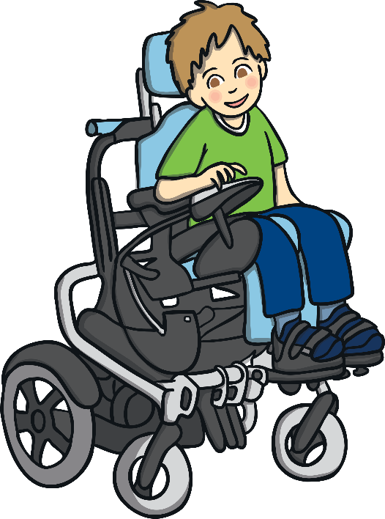
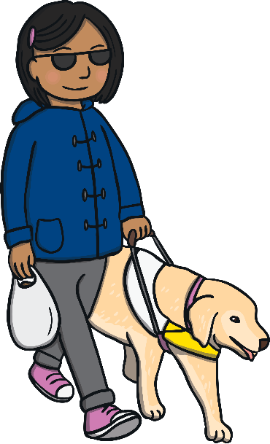
Who Does
BBC Children in Need Support?
BBC Children in Need supports children who might:
have a disability;
have a life-changing illness;
live in poverty;
be separated from their family;
care for someone in their family.

Slide 4


What BBC Children in Need Does
It helps us to think about things that we may take for granted that other children may not have.
It helps us to realise that some people are less fortunate than others.
It encourages everyone to get involved and raise money to help others.
It makes us aware of the lives of other children in the UK.

Slide 5

How Did it All Begin?
The BBC's first ever broadcast appeal for children was a five-minute radio broadcast on Christmas Day in 1927. The response was phenomenal and it raised money for a prominent children's charity.
The first televised appeal was the 1955 'Children's Hour Christmas Appeal’. The Christmas Day Appeals continued on TV and radio right up until 1979, with Terry Wogan presenting from 1978.
In 1980, the appeal was broadcast on BBC One in a new telethon format. It captured the public's imagination to such an extent that the donations increased dramatically and broke the million mark for the very first time.
Click to see
Pudsey Bear!

Slide 6

Pudsey Bear
Pudsey Bear made his television debut in 1985.
Click to see
Pudsey Bear!
He was designed by Joanna Ball, a BBC graphic designer, who named him after the West Yorkshire town where she was born.
He proved very popular and returned as BBC Children in Need's official logo the following year with a design change to that of a yellow bear with a red-spotted bandana.
In the years that followed, Pudsey has received letters, drawings and emails from youngsters all over the UK and has been photographed with more celebrities than he can remember.

Slide 7

How is Money Donated By
BBC Children in Need Used?
Giving families support so that they can spend time together.
Enabling children to become involved in sports.
Funding activities like play therapy.
Maintaining youth groups in different areas.
Giving children a safe place to play.
Giving children opportunities to take part in exciting activities.
Giving young carers time to have fun!

Slide 8
How Can You Help?
Every day, people everywhere are doing fantastic things to transform the lives of others and make our world a better place. This can be as simple as speaking up if something is unfair or doing practical things like fundraising or volunteering.
Think about your own role within our school or community. Perhaps you are a member of a club or the School Council? Maybe you just want to show how much you care?
Challenge yourself in a fun run.
Take part in a sponsored event.
Dress up for the day.
Take part in a talent show.
Hold a bake sale.
Do something amazing.

