Slide 2
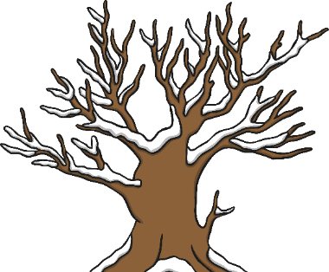
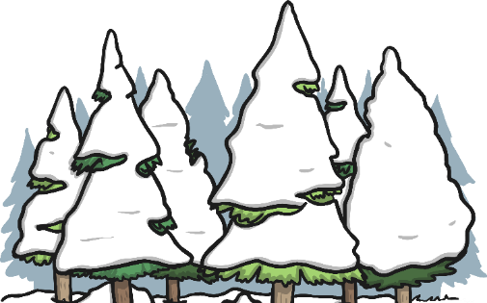
What Happens to Trees in Winter?
In winter the deciduous trees lose nearly all of their leaves. Tiny buds can be seen tightly wrapped together on tree branches. When the weather begins to warm in spring, the buds lengthen and begin to grow.
Evergreens keep their leaves.
People bring evergreen trees inside and decorate them as Christmas trees.

Slide 3
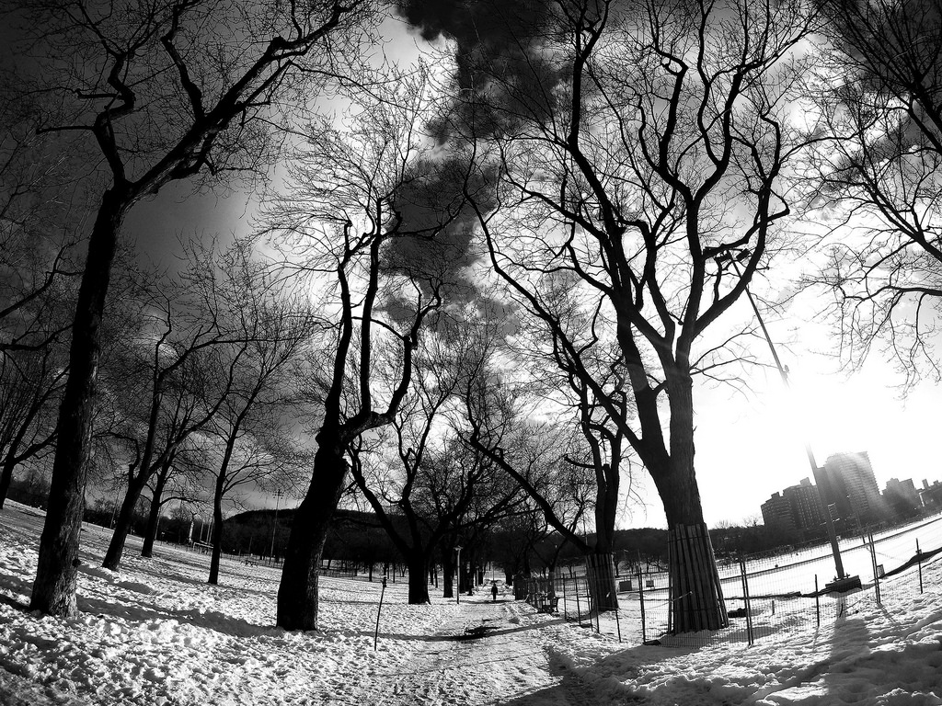
Looking Closely
Turn to the person sitting next to you and
describe how the trees look in the photo.
Do they remind you of anything?
“Post Winter Walk” by [Jason Thibault ] is licensed under CC BY 2.0

Slide 4
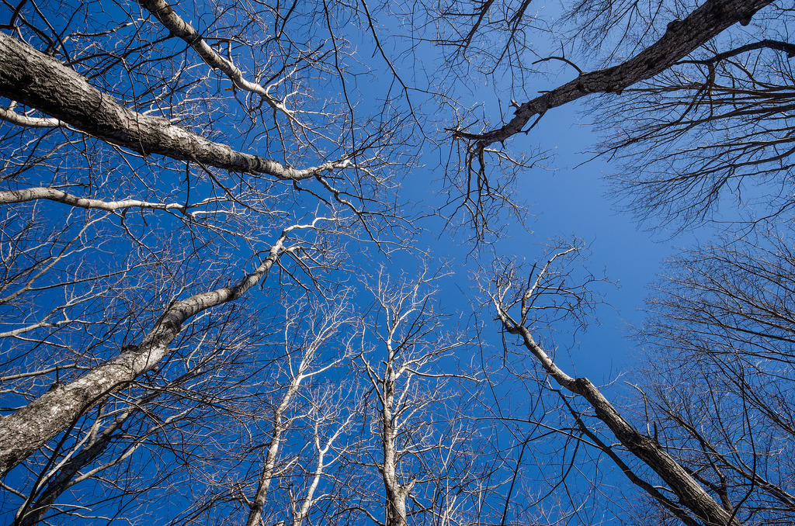
Without leaves, an artist can focus on the shapes made by the branches.
These shapes are unique to every tree, just like your fingerprints are to you!
What shapes can you see?
“Late Winter Hardwoods” by [Jack Flanagan] is licensed under CC BY 2.0

Slide 5

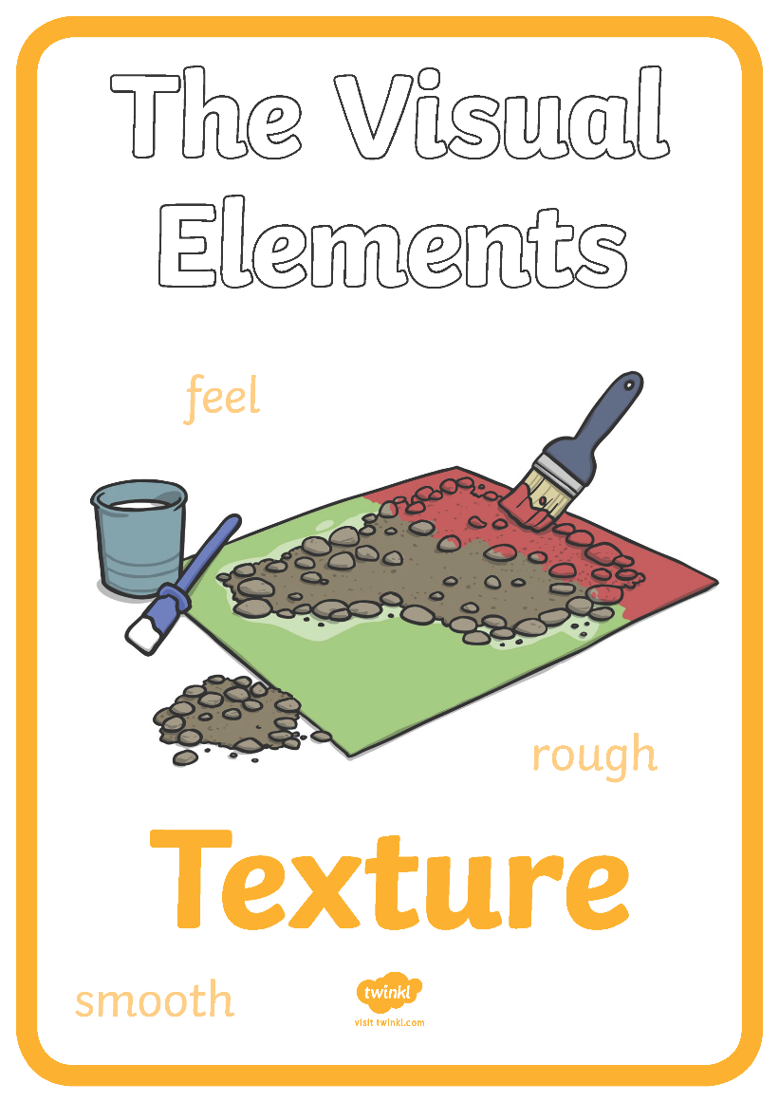
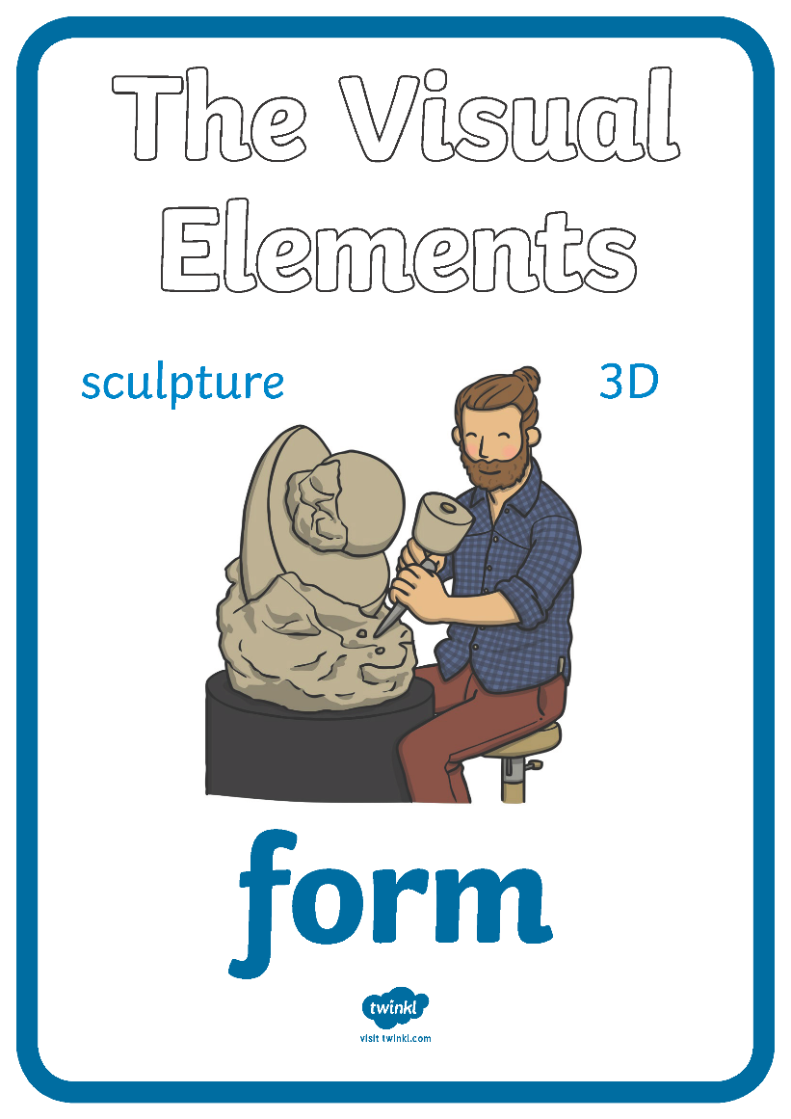
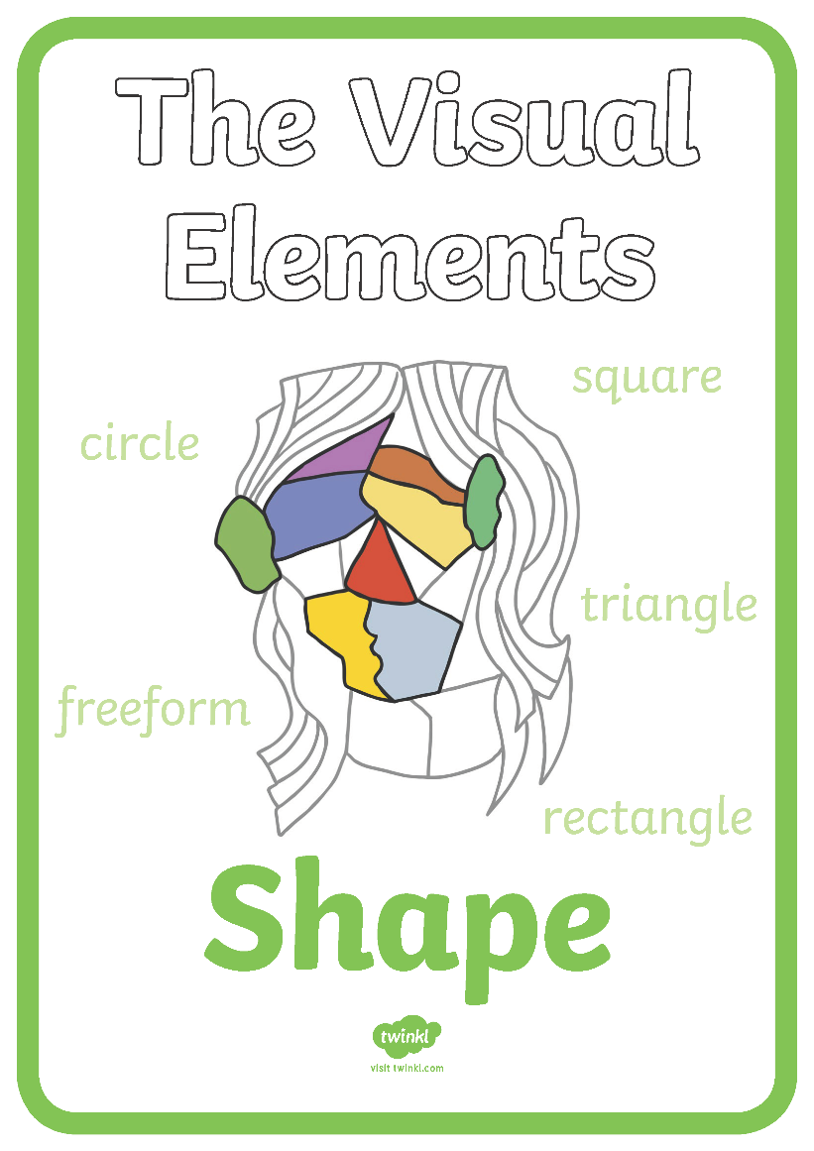
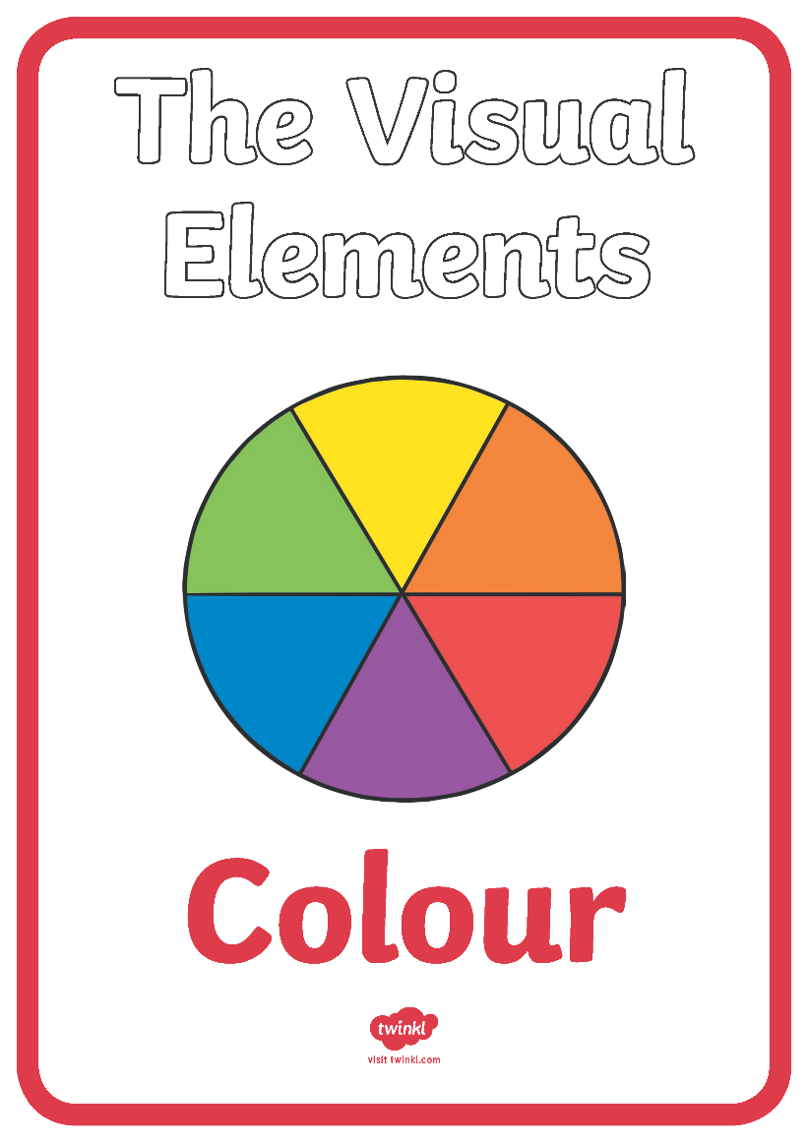
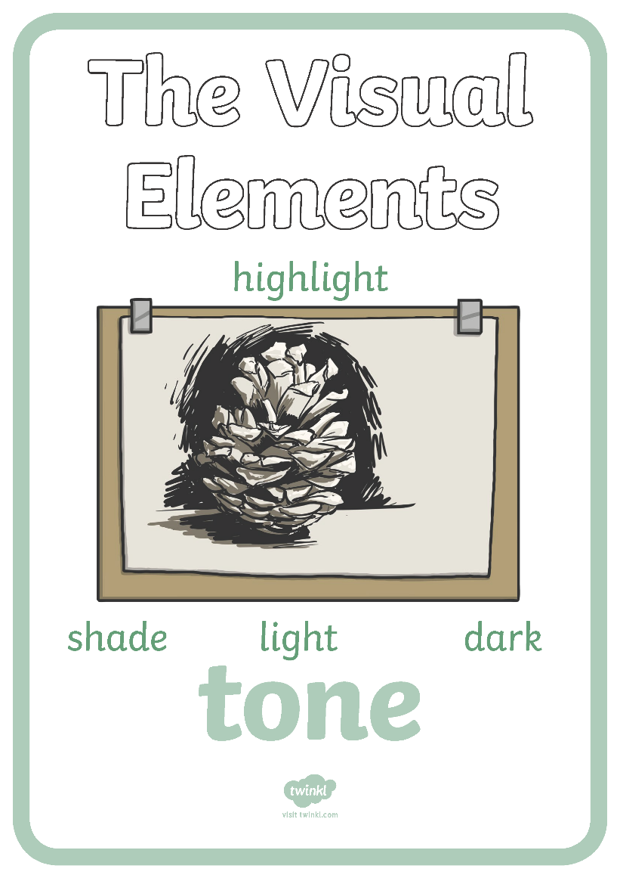

Visual Elements of Art
For today’s lesson we are going to explore the visual element of line.

Slide 6
Activity 1
Experimenting with line
Using a black pen, draw the different lines as they appear on the screen.
Can you draw:
a wavy line
a straight line
a curved line
a broken line
a jagged line
a spiraled line
v

Slide 7
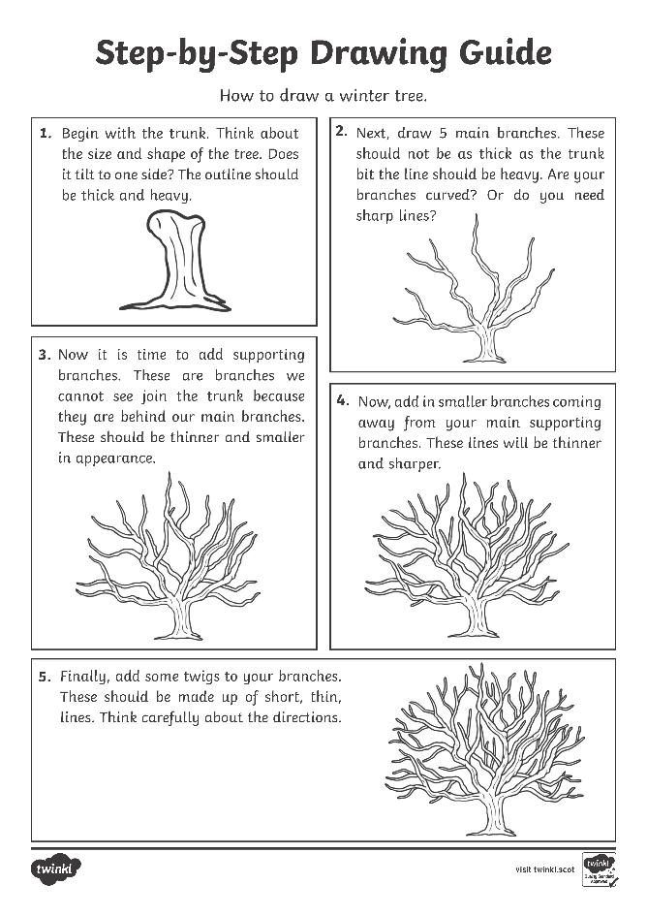

Activity 2
Using what you know about different lines,
it’s now time for you to draw a winter tree.

Slide 8

1.
^{Begin with the trunk.}
Think about the size and shape of the tree.
^{Does it tilt to one side?}
The outline should be thick and heavy.

Slide 9
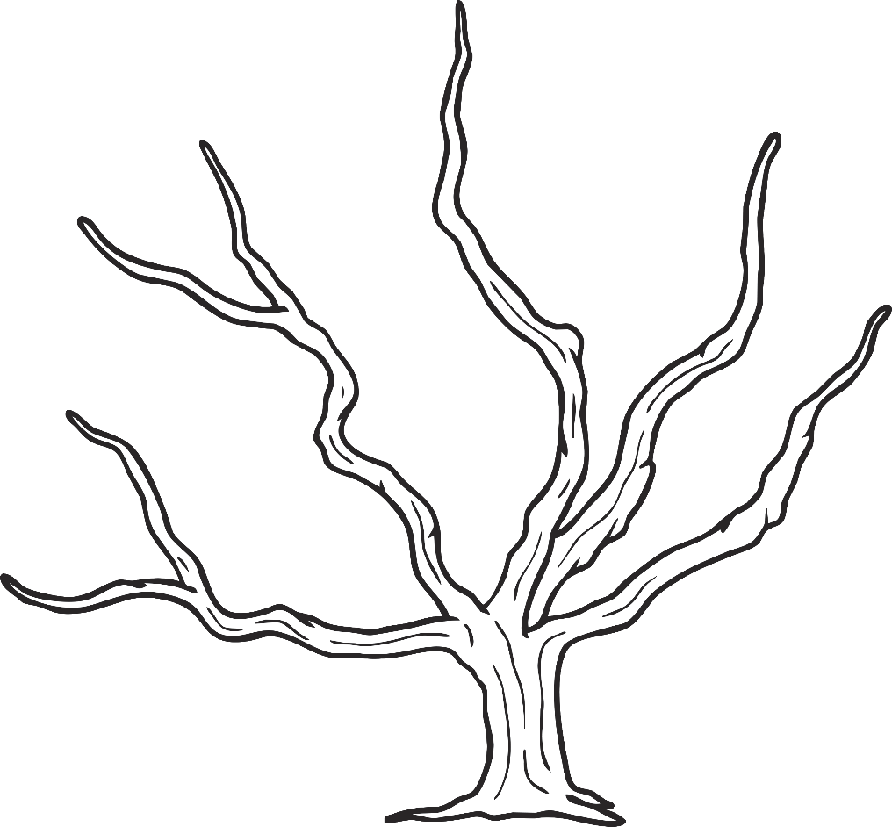
2.
Next, draw 5 main branches. These should not be as thick as the trunk bit the line should be heavy. Are your branches curved? Or do you need sharp lines?

Slide 10
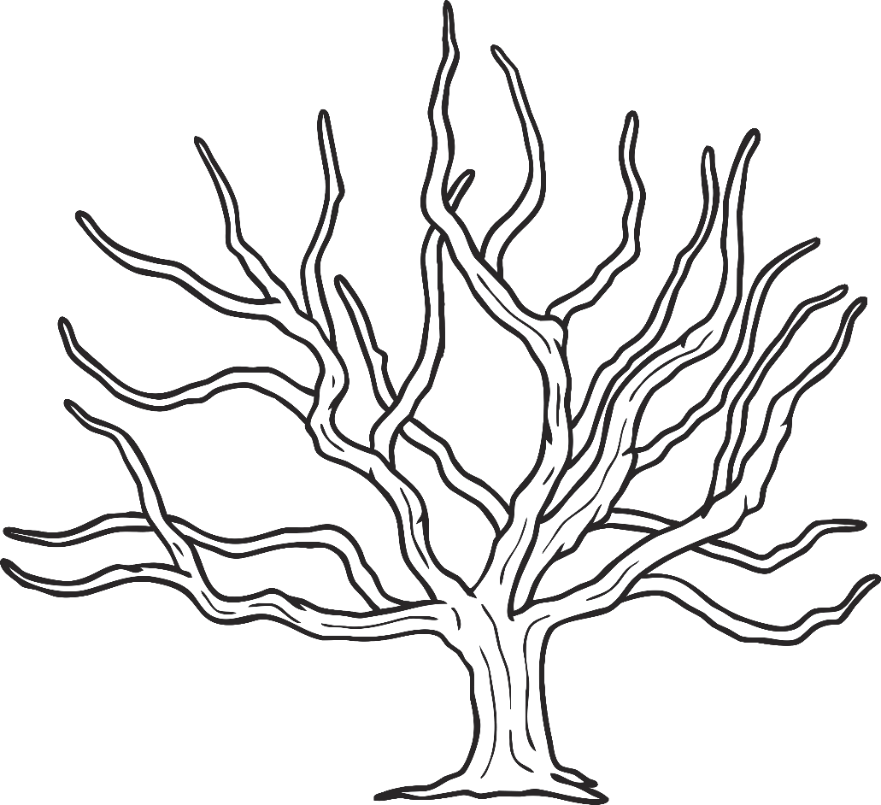
3.
Now it is time to add supporting branches. These are branches we cannot see join the trunk because they are behind our main branches. These should be thinner and smaller in appearance.

Slide 11
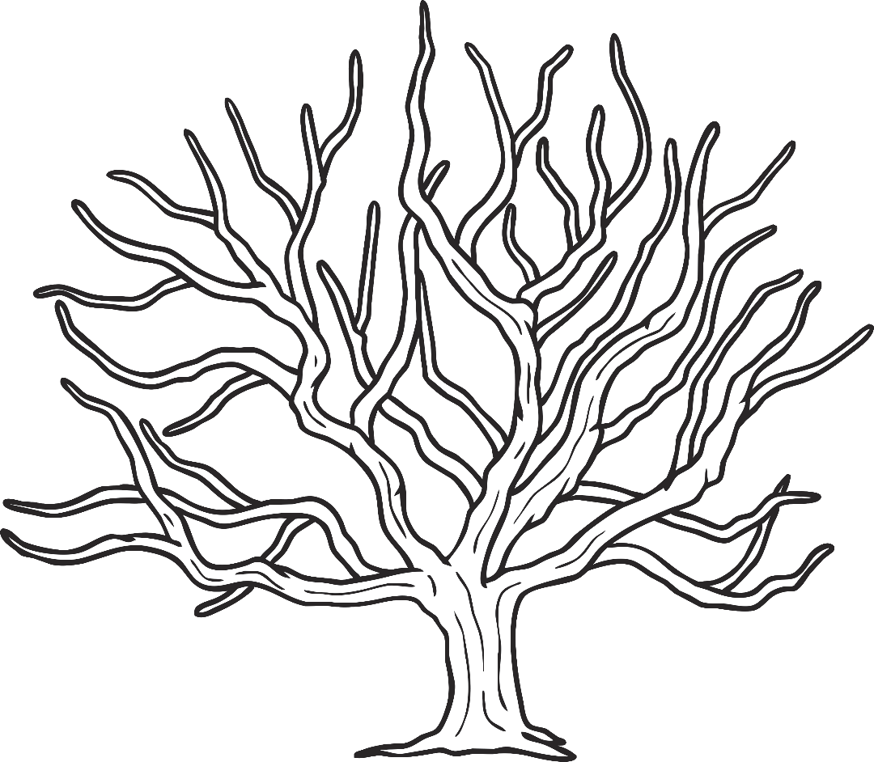
4.
Now, add in smaller branches coming away from your main supporting branches. These lines will be thinner and sharper.

Slide 12
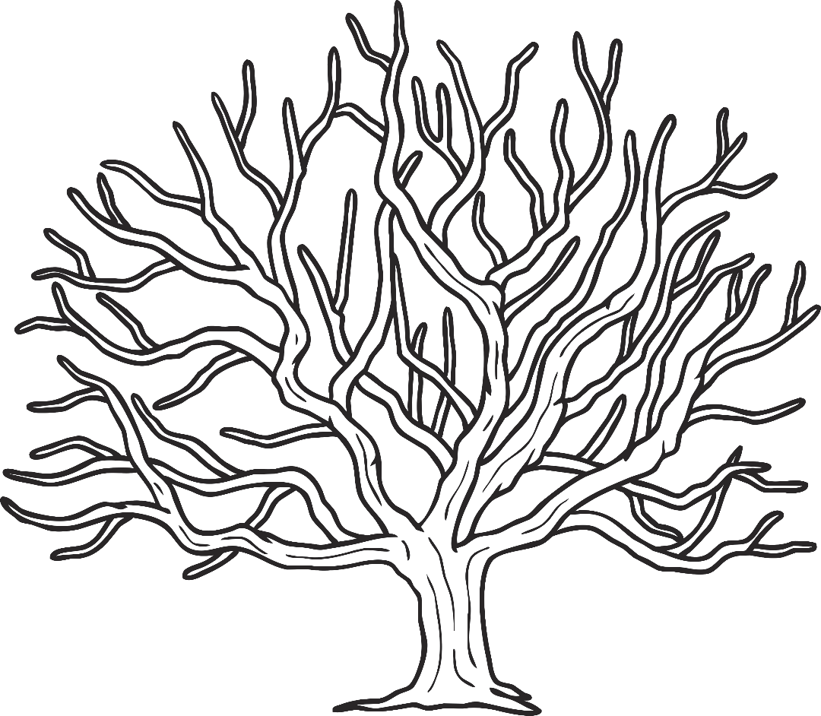
5.
Finally, add some twigs to your branches. These should be made up of short, thin, lines. Think carefully about the directions.

Slide 13

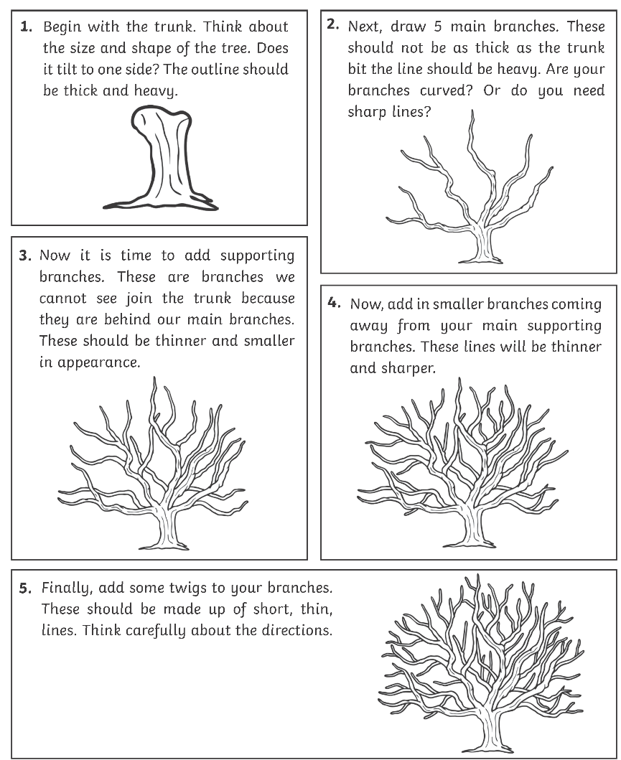
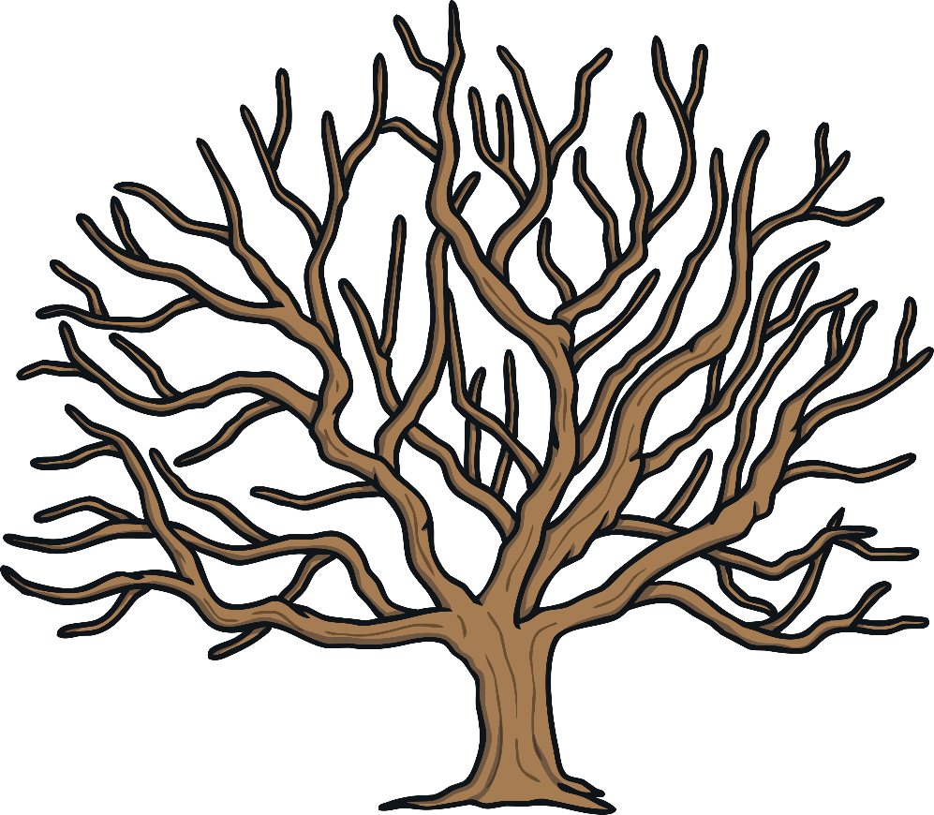
Activity 3
Now that we have learned the basics of drawing a winter tree, let’s paint one!

