Slide 1
Year 5 - Autumn - Block 3
Statistics

Slide 2
The graph shows the number of cars sold by two different companies.
3,500
3,000
2,500
2,000
Cars sold
1,500
1,000
500
0
Jan
Feb
Mar
Apr
May
Month

Slide 3
How many more cars did Ace Motors sell than Briggs in April?
From January to March, how many cars did each company sell? Who sold more? How many more did they sell?
Crooks Motors sold 250 more cars than Briggs each month.
Plot Crooks Motors’ sales on the graph.

Slide 4
Match the graph to the activity.
A car travels at constant speed on the motorway.
Distance from start
Time
A car is parked outside a house.
Distance from start
Time
A car drives to the end of the road and back.
Distance from start
Time

Slide 5
Encourage the children to collect their own data and present it as a line graph.
As this objective is taken from the science curriculum, it would be a good idea to link it to investigations.
Possible investigations could be:
• Measuring shadows over time
• Melting and dissolving substances
• Plant growth

Slide 6
Here is a table of data.
Which intervals would be the most appropriate for the vertical axis of the line graph?
Explain your answer.
Time (min) | 15 | 30 | 45 | 60 | 75
Distance (km) | 25 | 46 | 67 | 72 | 98

Slide 7
Rosie has used the data in the table to plot the line graph.
What mistakes has Rosie made?
Can you draw the line graph correctly?
Time | 11:00 | 11:20 | 11:40 | 12:00 | 12:20 | 12:40 | 13:00
Height above ground (m) | 0 | 180 | 150 | 200 | 210 | 120 | 0

Slide 8
240
200
160
120
Height above ground (m)
80
40
0
11:00
11:20
11:40
12:00
12:20
12:40
13:00
Time
Time | 11:00 | 11:20 | 11:40 | 12:00 | 12:20 | 12:40 | 13:00
Height above ground (m) | 0 | 180 | 150 | 200 | 210 | 120 | 0

Slide 9
Carry out your own exercise experiment and record your heart rate on a graph like the one shown in the section above. How does it compare?
Can you make a set of questions for a friend to answer about your graph?
Can you put the information into a table?

Slide 10
Here is a line graph showing a bath time. Can you write a story to explain what is happening in the graph?
Bath Time
30
25
20
Height (cm)
15
10
5
0
0
1
2
3
4
5
6
7
8
9
10
11
12
13
14
15
16
17
18
19
20
Time (minutes)

Slide 11
How long did it take to fill the bath?
How long did it take to empty?
The bath doesn’t fill at a constant rate. Why might that be?
Bath Time
30
25
20
Height (cm)
15
10
5
0
0
1
2
3
4
5
6
7
8
9
10
11
12
13
14
15
16
17
18
19
20
Time (minutes)

Slide 12
 | 100 m sprint (s) | Shot put (m) | 50 m Sack race (s) | Javelin (m)
Amir | 15.5 | 6.5 | 18.9 | 11.2
Dora | 16.2 | 7.5 | 20.1 | 13.3
Teddy | 15.8 | 6.9 | 19.3 | 13.9
Rosie | 15.6 | 7.2 | 18.7 | 14.1
Ron | 17.9 | 6.3 | 18.7 | 13.3
Ron thinks that he won the 100 m sprint because he has the biggest number.
Do you agree?
Explain your answer.

Slide 13
This table shows the 10 largest stadiums in Europe.
Stadium | City | Country | Capacity
Camp Nou | Barcelona | Spain | 99,365
Wembley | London | England | 90,000
Signal Iduna Park | Dortmund | Germany | 81,359
Santiago Bernabeu | Madrid | Spain | 81,044
San Siro | Milan | Italy | 80,018
Stade de France | Paris | France | 80,000
Luzhniki Stadium | Moscow | Russia | 78,300
Ataturk Olimpiyat Stadium | Istanbul | Turkey | 76,092
Old Trafford | Manchester | England | 75,811
Allianz Arena | Munich | Germany | 75,000

Slide 14
True or False?
The fourth largest stadium is the San Siro.
There are 6 stadiums with a capacity of more than 80,000
Three of the largest stadiums are in England.

Slide 15
This table shows how many children own dogs and cats.
Fill in the missing gaps and answer the questions below.
How many more boys have dogs than girls?
How many more girls have cats than dogs?
How many more children have dogs than cats?
 | Boys | Girls | Total
Dogs |  | 44
Cats | 38
Total | 125 |  | 245

Slide 16
120 people were asked where they went on
holiday during the summer months of last year.
Use this information to create a two-way table.
In June, 6 people went to France and 18 went to Spain.
In July, 10 people went to France and 19 went to Italy.
In August,15 people went to Spain.
35 people went to France altogether.
39 people went to Italy altogether.
35 people went away in June.
43 people went on holiday in August.
 | France | Spain | Italy | Total
June
July
Aug
Total

Slide 17
Ron wants to watch the following TV programmes:
Cheese Please, What’s the Q, aMAZEment, Budget Baker, Safari, Dance & Decide.
Will Ron be able to watch all the shows he has chosen?
It is 18:45. How long is it until ‘Guess the Noise’ is on?

Slide 18
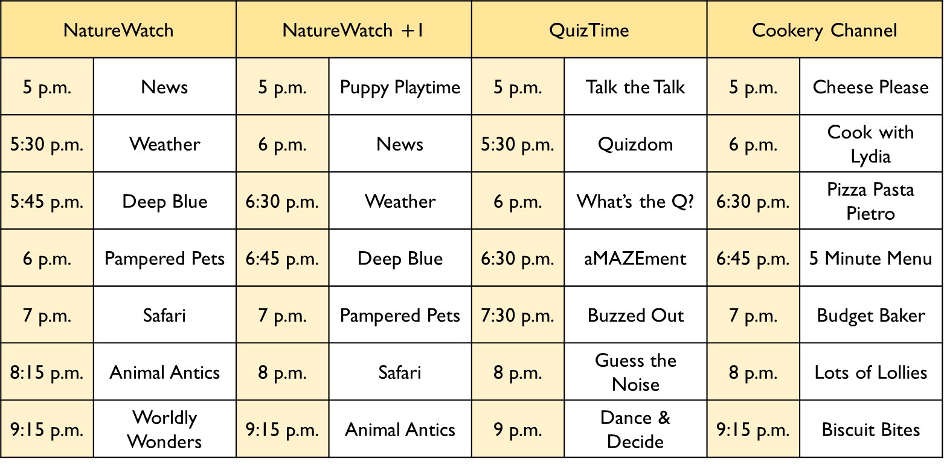
NatureWatch |  | NatureWatch $+$1 |  | QuizTime |  | Cookery Channel
5 p.m. | News | 5 p.m. | Puppy Playtime | 5 p.m. | Talk the Talk | 5 p.m. | Cheese Please
5:30 p.m. | Weather | 6 p.m. | News | 5:30 p.m. | Quizdom | 6 p.m. | Cook with Lydia
5:45 p.m. | Deep Blue | 6:30 p.m. | Weather | 6 p.m. | What’s the Q? | 6:30 p.m. | Pizza Pasta Pietro
6 p.m. | Pampered Pets | 6:45 p.m. | Deep Blue | 6:30 p.m. | aMAZEment | 6:45 p.m. | 5 Minute Menu
7 p.m. | Safari | 7 p.m. | Pampered Pets | 7:30 p.m. | Buzzed Out | 7 p.m. | Budget Baker
8:15 p.m. | Animal Antics | 8 p.m. | Safari | 8 p.m. | Guess the Noise | 8 p.m. | Lots of Lollies
9:15 p.m. | Worldly Wonders | 9:15 p.m. | Animal Antics | 9 p.m. | Dance & Decide | 9:15 p.m. | Biscuit Bites

Slide 19
Here is Rosie’s weekly timetable from secondary school.
Y7CMc | Daily Assembly (09:00 – 09:15) | 1 09:15 - 09:55 | 2 09:55 - 10:45 | Break (10:45 – 11:05) | 3 11:05 - 11:55 | 4 11:55 - 12:45 | Lunchtime (12:45 – 13:45) | 5 13:45 -14:35 | 6 14:35 - 15:25
Monday |  | Literacy | English |  | Maths | I.C.T. |  | P.S.H.C.E. | Geography
Tuesday |  | English | Art |  | French | Science |  | D.T.
Wednesday |  | Literacy | D.T. |  | Art | Drama |  | I.C.T. | Science
Thursday |  | P.E. | Maths |  | R.E. | English |  | History | P.S.H.C.E.
Friday |  | Literacy | Maths |  | Art | Science |  | P.E.

Slide 20
True or False?
Rosie has 2 hours and 20 minutes of PE in a week.
Rosie has 130 minutes of literacy in a week.
Rosie does Art for the same length of time as Maths each week.
Rosie does Art for the same length of time as English each week.

