Slide 2



Diving into Mastery Guidance for Educators
Each activity sheet is split into three sections, diving, deeper and deepest, which are represented by the following icons:
These carefully designed activities take your children through a learning journey, initially ensuring they are fluent with the key concept being taught; then applying this to a range of reasoning and problem-solving activities.
These sheets might not necessarily be used in a linear way. Some children might begin at the ‘Deeper’ section and in fact, others may ‘dive straight in’ to the ‘Deepest’ section if they have already mastered the skill and are applying this to show their depth of understanding.
Diving
Deeper
Deepest

Slide 3
Aim
Complete, read and interpret information in tables,
including timetables.

Slide 4
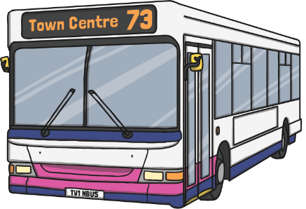
Timetables
Diving
Look at this bus timetable and complete the missing times:
Bus Timetable
Twinkl Station | 06:37 |  | 12:00 | 18:45
Twinkl Airport |  | 09:40 | 12:20
Twinkl City Centre | 07:15 | 09:58 | 12:38
Twinkl Hotel | 07: 43 | 10:26 |  | 19:51
09:20
06:57
19:05
19:23
13:06
Which bus should I catch from Twinkl Station to arrive at the Twinkl Hotel
by 8 p.m.?
You would need to catch the 18:45 bus.
If I catch the 9:40 bus from Twinkl Airport, what time will I
arrive at the Twinkl Hotel?
You will arrive at 10:26.
How long will my journey take to the Twinkl City Centre if I catch
the 06:37 bus from Twinkl Station?
It will take 38 minutes.

Slide 5

Timetables
Deeper
This is part of a school timetable:
 | 9:15 – 10:00 | 10:00 – 10:45 | Break (10:45 – 11:15) | 11:15 – 12:30 | Lunch (12:30 – 1:15) | 1:15 – 2:15 | 2:15 – 3:15
Mon | English | PE |  | DT |  | Science | Maths
Tue | Maths | Music |  | English |  | PE | Computing
Wed | English | Science |  | History |  | Maths | Geography
Decide if the following statements are true or false, explaining your reasoning.
At 13:50 on a Tuesday, I would be in a science lesson.
False. You would be in a PE lesson.
z
There is the same amount of time spent in maths as there is English.
True. 165 minutes are spent in maths and 165 minutes in English.
There is more time spent at break and lunch than in science, history, geography and computing combined.
False. 225 minutes are spent at break and lunch compared to
300 minutes in science, history, geography and computing.

Slide 6


Timetables
Deepest
Use the statements below in order to create your own school timetable for
Monday, Tuesday and Wednesday:
Here is one example timetable.
 | 9:15 – 10:00 | 10:00 – 10:45 | Break (10:45 – 11:15) | 11:15 – 12:30 | Lunch (12:30 – 1:15) | 1:15 – 2:15 | 2:15 – 3:15
Mon
Tue
Wed
 | 9:15 – 10:00 | 10:00 – 10:45 | Break (10:45 – 11:15) | 11:15 – 12:30 | Lunch (12:30 – 1:15) | 1:15 – 2:15 | 2:15 – 3:15
Mon | English | Maths |  | English |  | Maths | PE
Tue | Computing | Maths |  | PE |  | Maths | Computing
Wed | PE | English |  | Maths |  | Music | English
There should be between 190 and 240 minutes of English in total.
Music should take place from 1:15 until 2:15.
PE should be taught every day and one lesson should
last an hour.
Computing should be the first lesson and the last lesson
on one day.

Slide 7
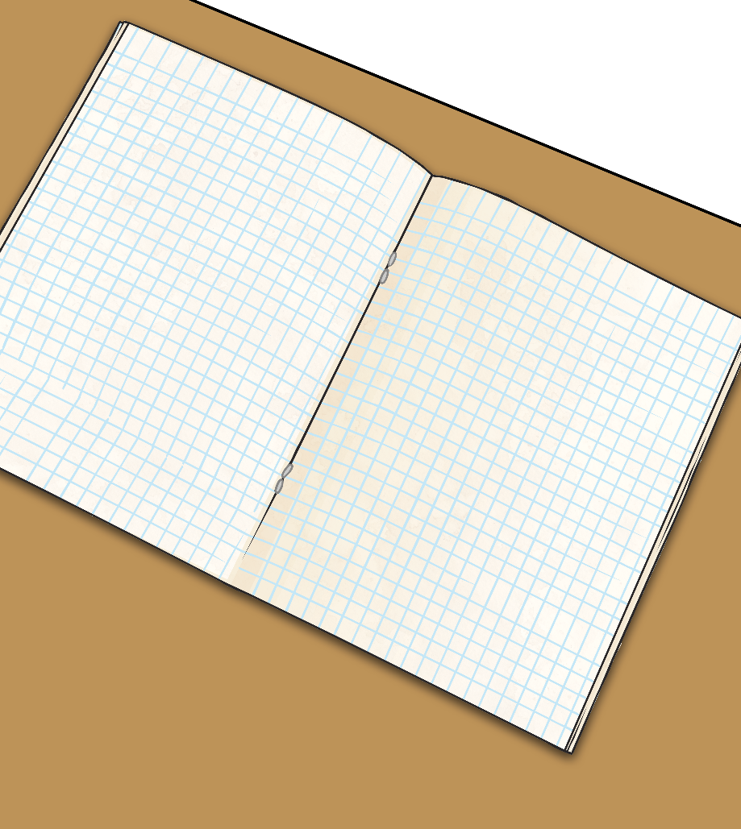
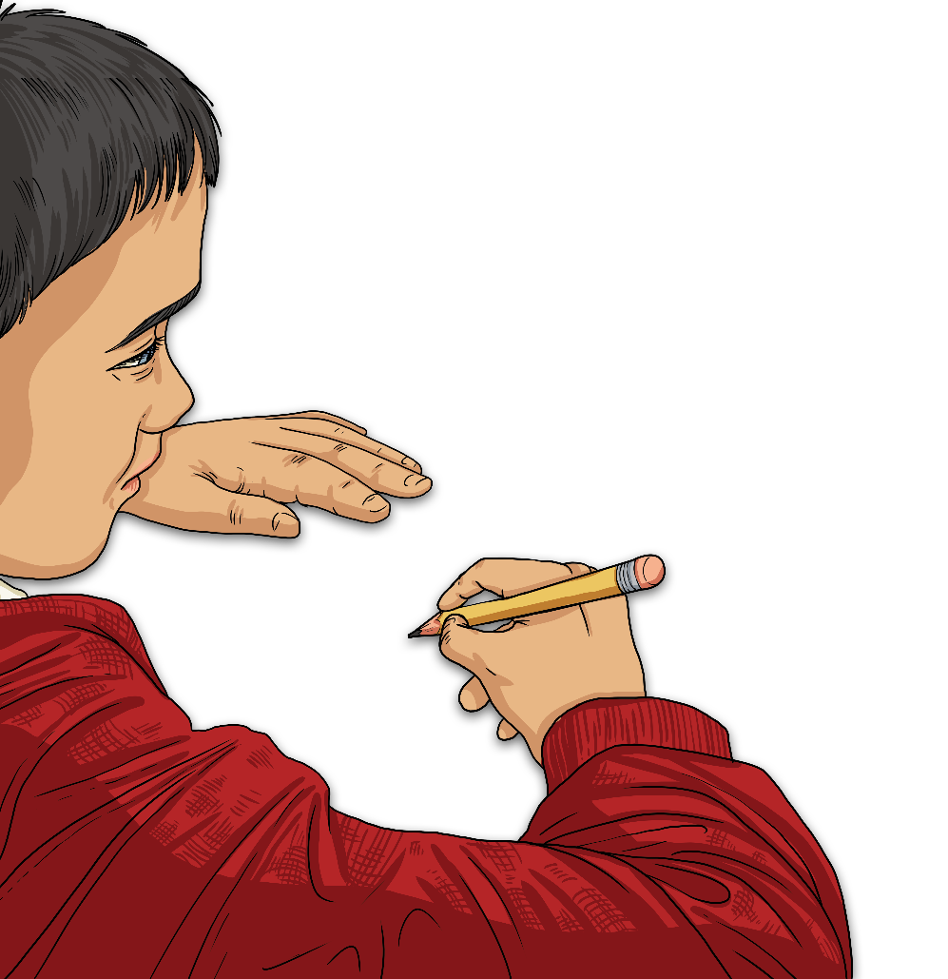
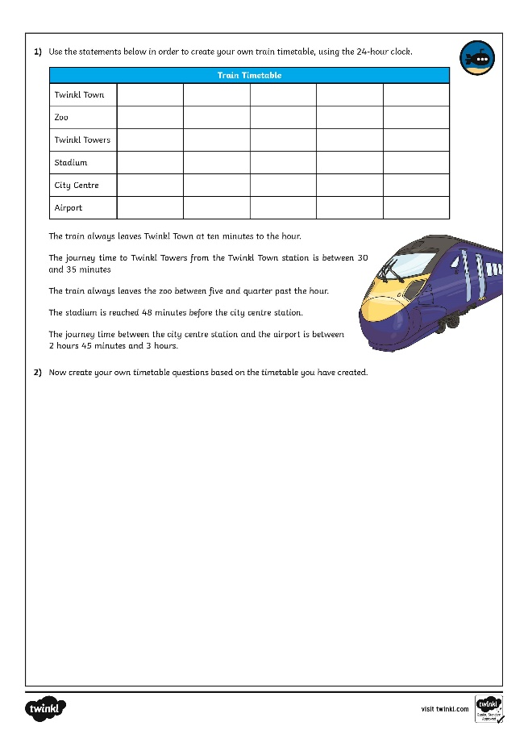
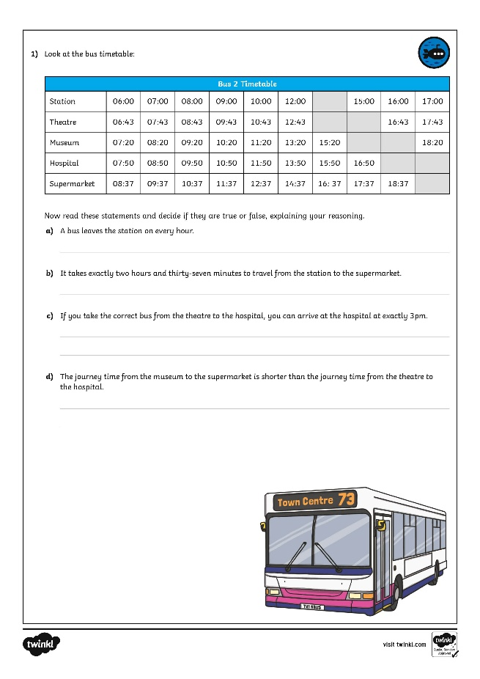
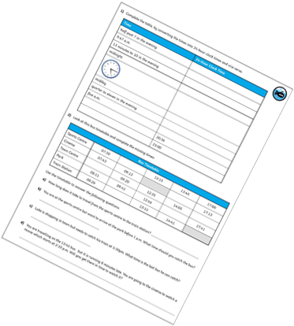
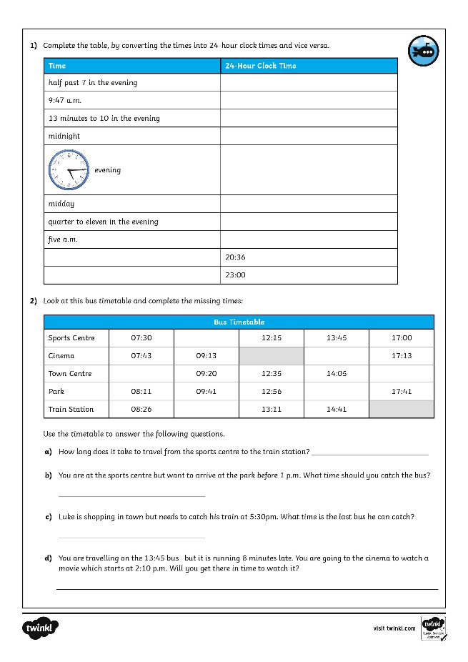
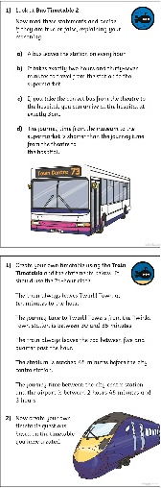
Timetables
Dive in by completing your own activity!

Slide 8
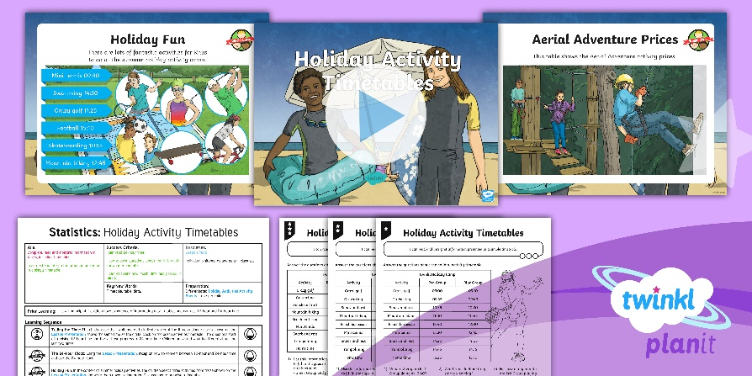
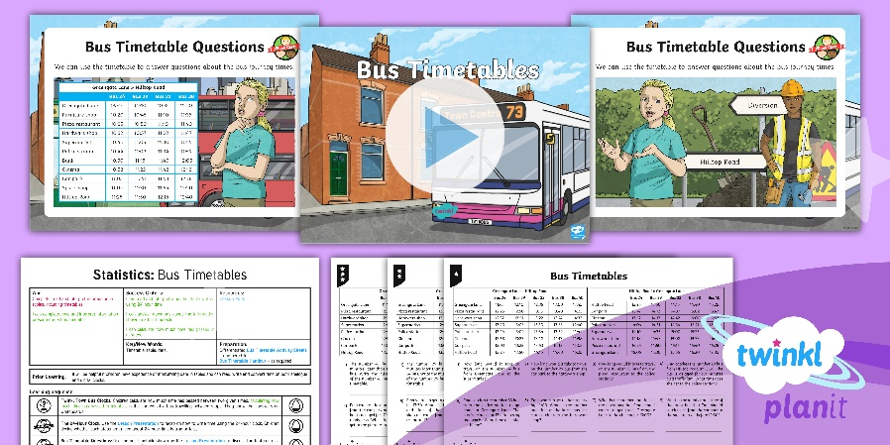

Need Planning to Complement this Resource?
National Curriculum Aim
Complete, read and interpret information in tables,
including timetables.
For more planning resources to support this aim, click here.
Twinkl PlanIt is our award-winning scheme of work
with over 4000 resources.

