Slide 2



Diving into Mastery Guidance for Educators
Each activity sheet is split into three sections, diving, deeper and deepest, which are represented by the following icons:
These carefully designed activities take your children through a learning journey, initially ensuring they are fluent with the key concept being taught; then applying this to a range of reasoning and problem-solving activities.
These sheets might not necessarily be used in a linear way. Some children might begin at the ‘Deeper’ section and in fact, others may ‘dive straight in’ to the ‘Deepest’ section if they have already mastered the skill and are applying this to show their depth of understanding.
Diving
Deeper
Deepest

Slide 3
Aim
Complete, read and interpret information in tables, including timetables.

Slide 4
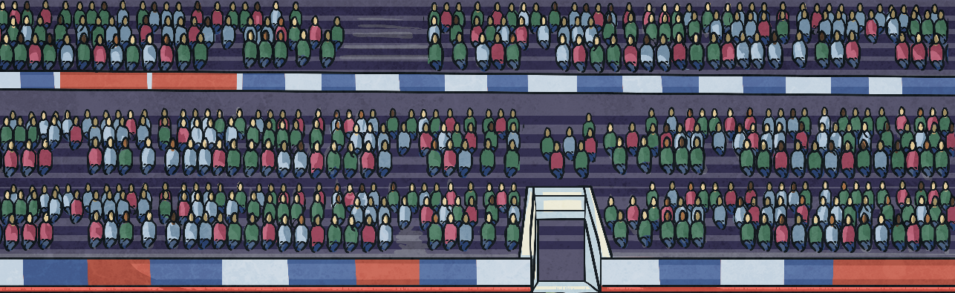

Read and Interpret Tables
Diving
This table shows the largest attendances ever recorded for a football match:
Wembley Stadium | 126 047
Salt Lake Stadium | 134 000
Maracana Stadium | 199 854
Hampden Park | 149 415
Estadio da Luz | 135 000
What is the total combined
attendance of the second and
third highest-attended matches?
What is the difference between the
highest-ever attendance and the
fifth highest-ever attendance?
Which stadiums have a
record attendance of between
125 000 and 136 000?
Which stadium had the highest-ever attendance for a football match?
Wembley Stadium, Salt Lake Stadium and Estadio da Luz
199 854 – 126 047 = 73 807
Maracana Stadium
149 415 + 135 000 = 284 415

Slide 5




Read and Interpret Tables
Deeper
This table shows the cost of parking in a car park:
True or False?
Under 1 Hour | Free
Between 1 and 2 Hours | £2.50
Between 2 and 4 Hours | £3.50
Between 4 and 6 Hours | £4.50
All Day | £5
I parked my car at 11:35 and came back at 15:45. The £3.50 I put in the parking machine was the correct amount for the time I spent in the car park.
I parked my car in the car park for only 15 minutes less than my friend but paid £2.50 less than he did to park.
I parked my car for 109 minutes. My friend parked for 235 minutes. The cost of his parking was £2 more than mine.
True. For example, if I parked my car for 50 minutes, this would have been free. If my friend parked for 65 minutes (which is only 15 minutes more), this would mean he had parked for over an hour, which would have cost him £2.50.
False. As the car had been parked for four hours and ten minutes, the cost would have been £4.50 rather than £3.50.
False. The cost of my parking would have been £2.50 as I parked for one hour and 49 minutes. My friend parked for three hours and 55 minutes and therefore he would have paid £3.50 to park. This means he only paid £1 more.

Slide 6

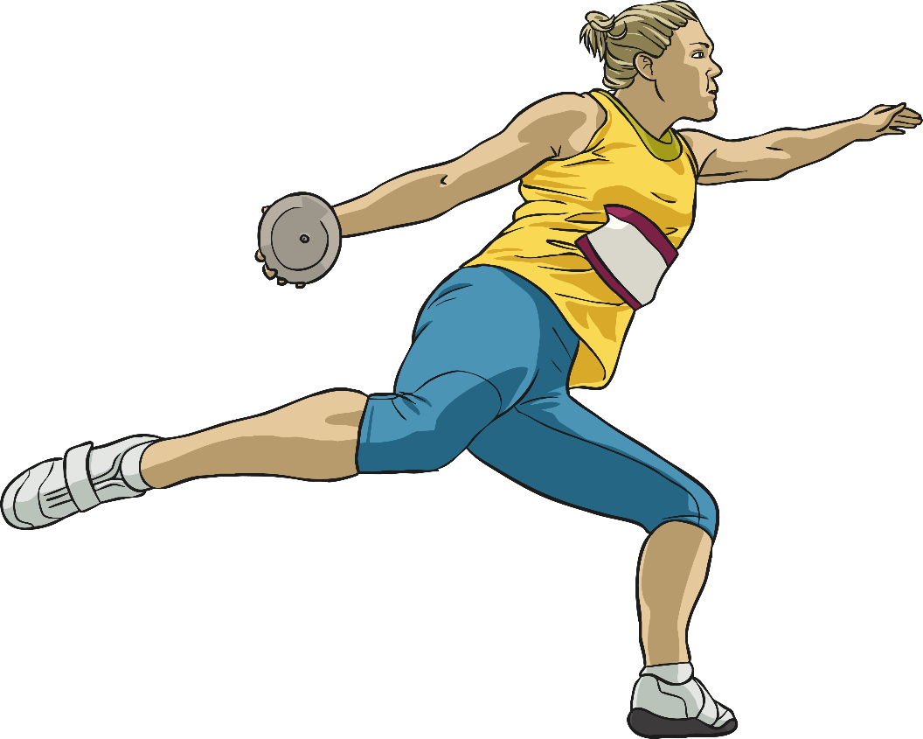
Read and Interpret Tables
Deepest
Some athletes took part in two different athletics throwing events and their distances were recorded in the table below:
Name | Shot Put (in Metres) | Discus (in Metres) | Total Distance (in Metres)
Yashpal | 12.93 | 60.65 | 73.58
Conor | 13.65 | 68.67
Kasia |  | 57.34 | 73.07
Jack | 14.08 |  | 77.95
Mia | 13.45 | 55.76
82.32
15.73
63.87
69.21
Fill in the missing distance for each athlete.

Slide 7
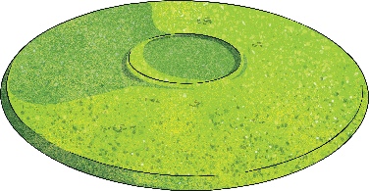

Read and Interpret Tables
Deepest
Klaudia threw a total distance of 81.5m. The distance of her shot put throw was between Yashpal’s and Kasia’s. What could Klaudia’s throwing distances have been in both events?
Various answers are possible. For example, Klaudia could have thrown 14m in the shot put. This means her discuss throw would have been 67.5m.
15.73 + 14.08 + 13.65 = 43.46
Rounded to the nearest metre, this is 43 metres.
If the distances from the discus throw are ordered from longest to shortest distance thrown, whose throw is the middle distance?
68.67, 63.87, 60.65, 57.34, 55.76 Yashpal’s throw is the middle distance.
Rounded to the nearest metre, what is the total distance thrown by the three furthest shot put throws?
Name | Shot Put (in Metres) | Discus (in Metres) | Total Distance (in Metres)
Yashpal | 12.93 | 60.65 | 73.58
Conor | 13.65 | 68.67 | 82.32
Kasia | 15.73 | 57.34 | 73.07
Jack | 14.08 | 63.87 | 77.95
Mia | 13.45 | 55.76 | 69.21

Slide 8


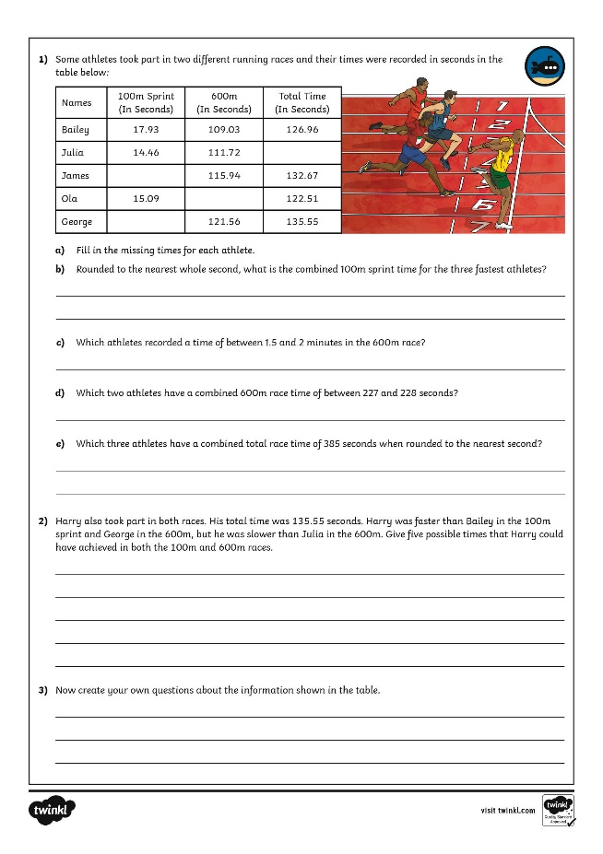
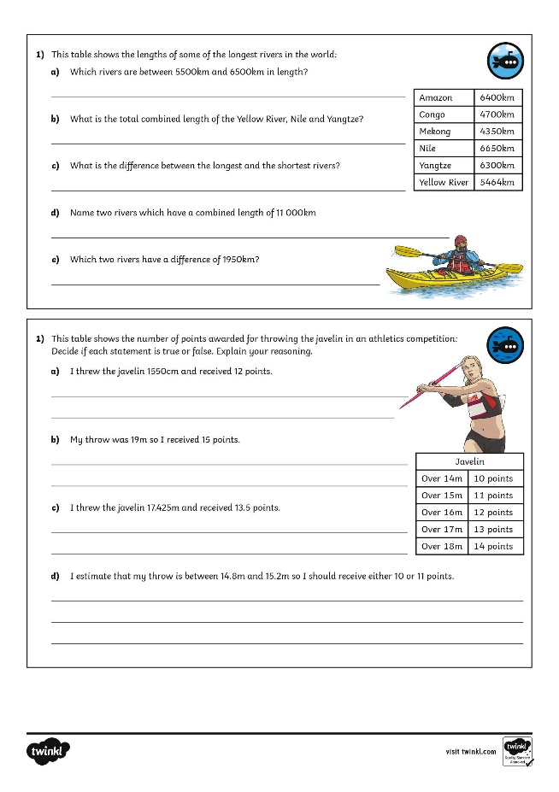
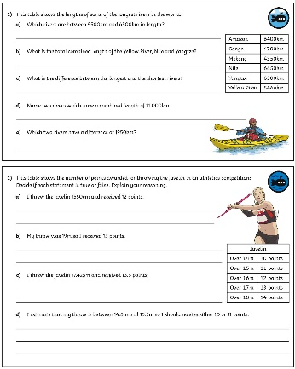
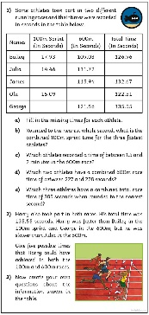
Read and Interpret Tables
Dive in by completing your own activity!

Slide 9
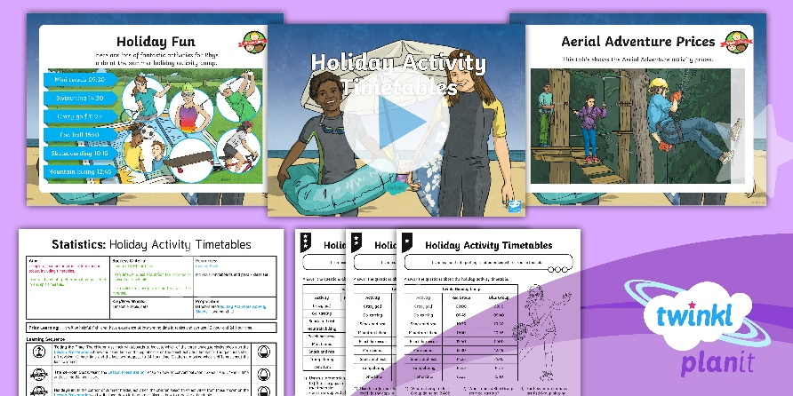
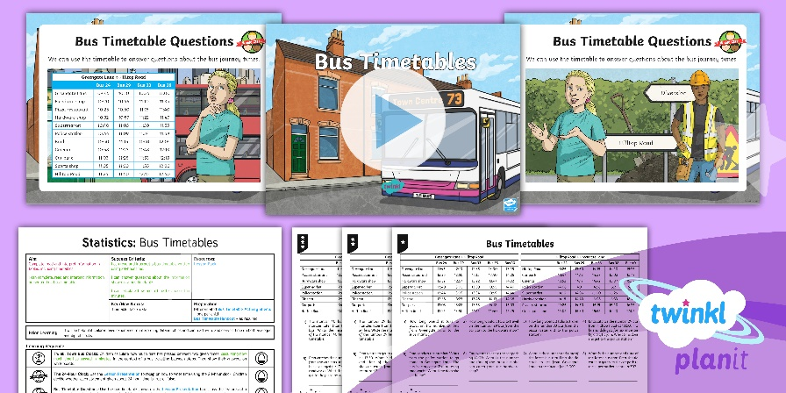

Need Planning to Complement this Resource?
National Curriculum Aim
Complete, read and interpret information in tables, including timetables.
For more planning resources to support this aim, click here.
Twinkl PlanIt is our award-winning scheme of work
with over 4000 resources.

