Slide 2
Diving into Mastery Guidance for Educators
Each activity sheet is split into three sections, diving, deeper and deepest, which are represented by the following icons:
These carefully designed activities take your children through a learning journey, initially ensuring they are fluent with the key concept being taught; then applying this to a range of reasoning and problem-solving activities.
These sheets might not necessarily be used in a linear way. Some children might begin at the ‘Deeper’ section and in fact, others may ‘dive straight in’ to the ‘Deepest’ section if they have already mastered the skill and are applying this to show their depth of understanding.
Diving
Deeper
Deepest

Slide 3
Aim
Solve problems involving converting between units of time.

Slide 4
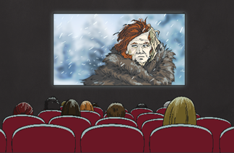
Converting Units of Time
Diving
Convert the units of time.
3 minutes and 9 seconds
1 hour and 25 minutes
3 weeks and 1 day
189
85
22
seconds
minutes
days

Slide 5
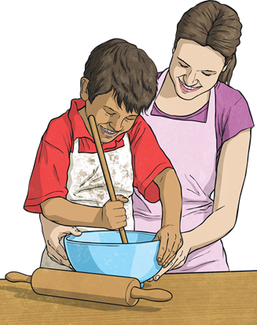
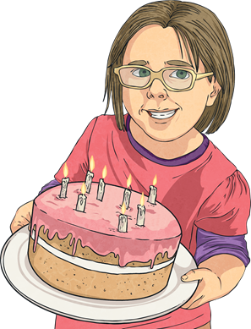
Converting Units of Time
Diving
Convert the units of time.
3 days and 8 hours
8 years and 4 months
2¾ hours
80
100
hours
165
months
minutes

Slide 6
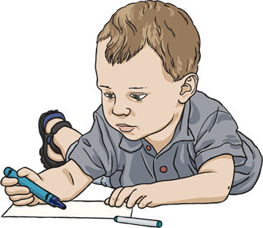
Converting Units of Time
Deeper
Gill
22 months
Tomek
730 days
Gill is the eldest child.
Is Sam correct? Explain your answer.
Sam is incorrect.
730 days equals 2 years and 22 months equals 1 year and 10 months.

Slide 7
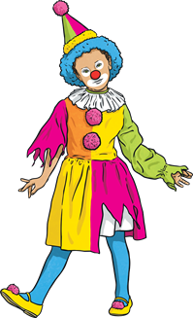
Converting Units of Time
Deeper
Here are four films and their running times:
Dance School is 120 seconds longer than Ghost House.
Clowning Around
1 hour and 56 minutes
Dance School
100 minutes
Ghost House
1 hour and 38 minutes
Superhero Squad
1¾ hours
Is Sam correct? Explain your answer.
Reveal answer
Sam is correct. Ghost House is 98 minutes and Dance School is 100 minutes. This is a difference of 2 minutes, which is equal to 120 seconds.

Slide 8
Converting Units of Time
Deepest
Ola is taking part in a sponsored silence for charity.
Three of Ola’s friends agree to sponsor her for the following amounts:
Ben
£1 for every 5 minutes
Michael
£1.50 for every 600 seconds
Lucie
£2.00 for every quarter of an hour
£6
£4.50
£4
a) How much will each friend give to Ola after 30 minutes of silence?

Slide 9
Converting Units of Time
Deepest
Ola is taking part in a sponsored silence for charity.
Three of Ola’s friends agree to sponsor her for the following amounts:
Ben
£1 for every 5 minutes
Michael
£1.50 for every 600 seconds
Lucie
£2.00 for every quarter of an hour
b) How much money will Ola earn in total after 195 minutes of silence?
£94.25

Slide 10
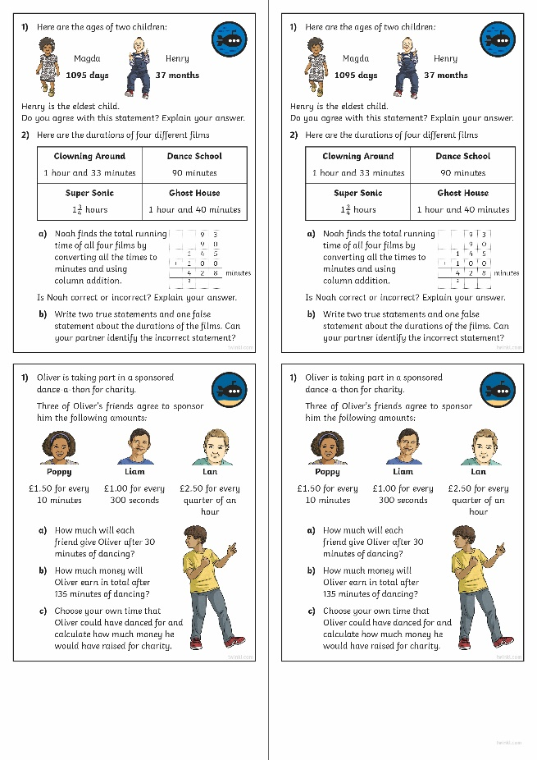
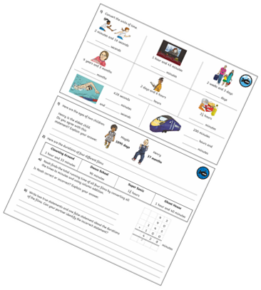
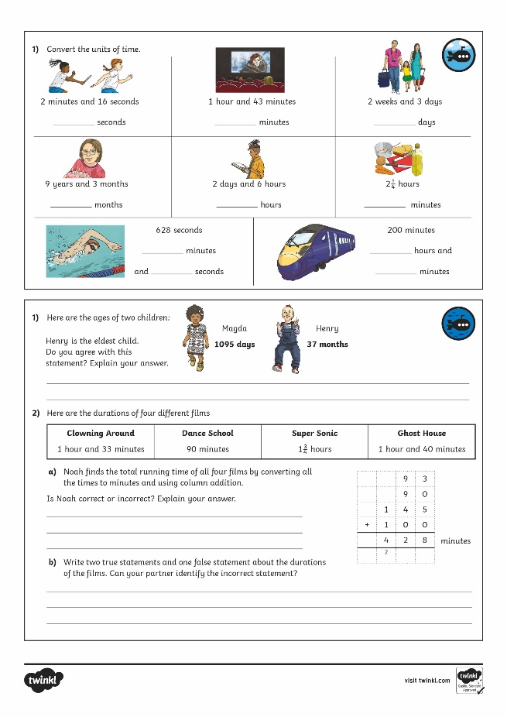
Calculating Angles on a Straight Line
Dive in by completing your own activity!

Slide 11
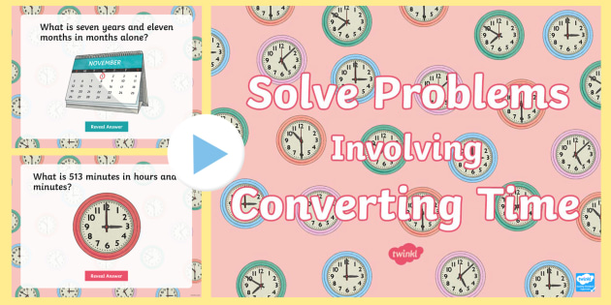
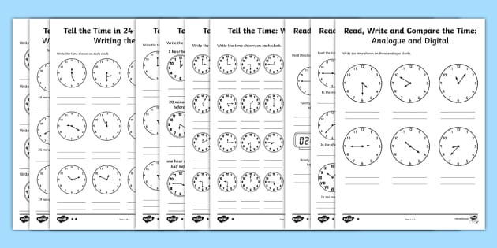
Need Planning to Complement this Resource?
National Curriculum Aim
Solve problems involving converting between units of time.
For more planning resources to support this aim, click here.
Twinkl PlanIt is our award-winning scheme of work with over 4000 resources.

