Slide 4
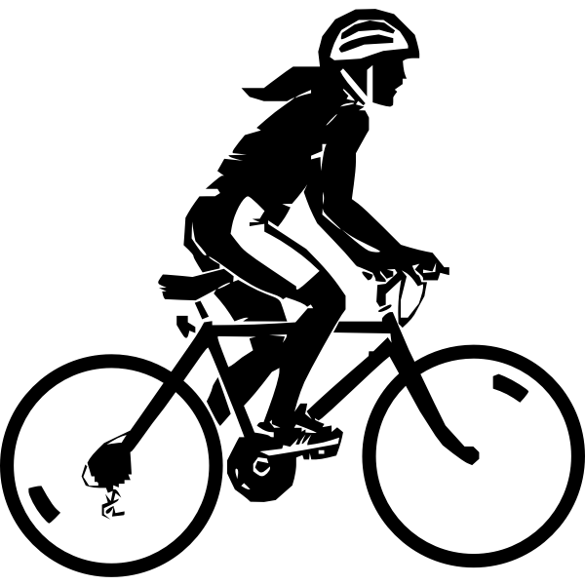
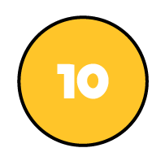
A cyclist rides 4,154 km in May.
In June she cycles 1,522 km.
How many more km does she cycle during May?
2,632 km
Th | H | T | O
Th | H | T | O
4 | 1 | 5 | 4
1 | 5 | 2 | 2
3
1
May
4,154
$$−$$
?
June
1,522
2
6
3
2
1 hundred $−$ 5 hundreds $=$
11 hundreds $−$ 5 hundreds $=$
1 thousand = 10 hundreds

Slide 5
1 ten = ____ ones
1 hundred = ____ tens
1 thousand = ____ hundreds
10
Have a think
10
10

Slide 6
8,231 $−$ 7,620 =
611
Th | H | T | O
Th | H | T | O
8 | 2 | 3 | 1
7 | 6 | 2 | 0
7
1
0
6
1
1

Slide 7
Have a go at questions 1 - 5 on the worksheet

Slide 8
2,534 $−$ 1,702 =
832
Th | H | T | O
2 | 5 | 3 | 4
1 | 7 | 0 | 2
1 | 2 | 3 | 2
Th | H | T | O
2 | 5 | 3 | 4
1 | 7 | 0 | 2
 |  | 3 | 2
Have a think
1
1
$$−$$
$$−$$
0
8
15 hundreds $–$ 7 hundreds
5 hundreds – 7 hundreds
7 hundreds – 5 hundreds

Slide 9
Have a think
The answer to 1,364 $−$ 630 will have 1 thousand because there is nothing to subtract from 1 thousand
Explain why Dexter is not correct.
Th | H | T | O
1 | 3 | 6 | 4
 | 6 | 3 | 0
 |  | 3 | 4
0
1
$$−$$
7

Slide 10
During a dance competition, Ron scores a total of 3,527 points. He scores 1,447 points in the morning. How many points does he score in the afternoon?
2,080 points
3,527 Total points
Th | H | T | O
3 | 5 | 2 | 7
1 | 4 | 4 | 7
4
1
$$−$$
1,447
?
2
0
8
0
Morning
Afternoon

Slide 11
Have a go at questions 6 - 9 on the worksheet

