Slide 2



Diving into Mastery Guidance for Educators
Each activity sheet is split into three sections, diving, deeper and deepest, which are represented by the following icons:
These carefully designed activities take your children through a learning journey, initially ensuring they are fluent with the key concept being taught; then applying this to a range of reasoning and problem-solving activities.
These sheets might not necessarily be used in a linear way. Some children might begin at the ‘Deeper’ section and in fact, others may ‘dive straight in’ to the ‘Deepest’ section if they have already mastered the skill and are applying this to show their depth of understanding.
Diving
Deeper
Deepest

Slide 3
Aim
Recall and use multiplication and division facts for the 3, 4 and 8 multiplication tables.

Slide 4
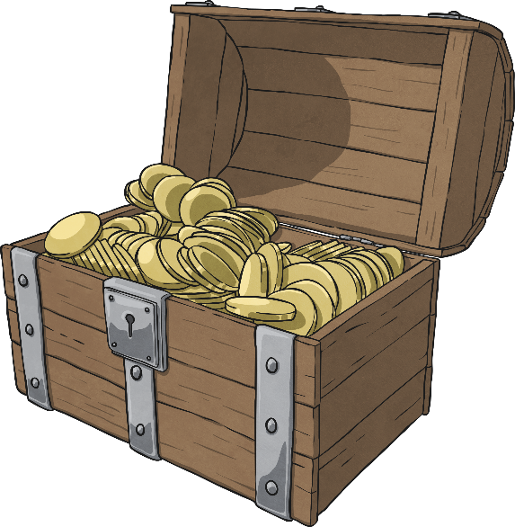

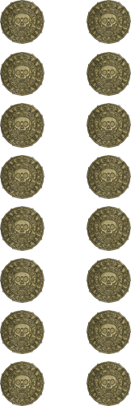
The 8 Times Table
Diving
Complete these statements.
8
1 chest contains 8 gold coins.
2 chests contain gold coins.
chests contain 40 gold coins.
10 chests contain gold coins.
16
5
80
Which statements match this image?
8 ÷ 16 = 2
2 x 8 = 16
16 ÷ 8 = 2

Slide 5

The 8 Times Table
Deeper
Which models represent facts from the eight times table?
Explain your reasons.
This model is correct. It shows 4 groups of 8 equalling 32.
32
8 | 8 | 8 | 8
This model is not correct.
This model shows two parts of 2 × 8, which each equal 16. The whole shows 5 × 8. 2 × 8 and 2 × 8 would only equal 4 × 8.
2 × 8
5 × 8
2 × 8
This model is correct. It shows 6 × 8 = 48 or 48 ÷ 8 = 6.

Slide 6


The 8 Times Table
Deepest
Pirate Priti has fewer than 45 parrots to arrange into cages
on the pirate ship.
If she sorts them in groups of eight, she has none left over.
If she sorts them into groups of three, she has two left over.
How many parrots could she have?
Find all the possibilities.
Possible Multiples of 8
8
16
24
32
40
Number Left If Divided into Groups of 3
2
1
0
2
1
8 parrots
32 parrots

Slide 7
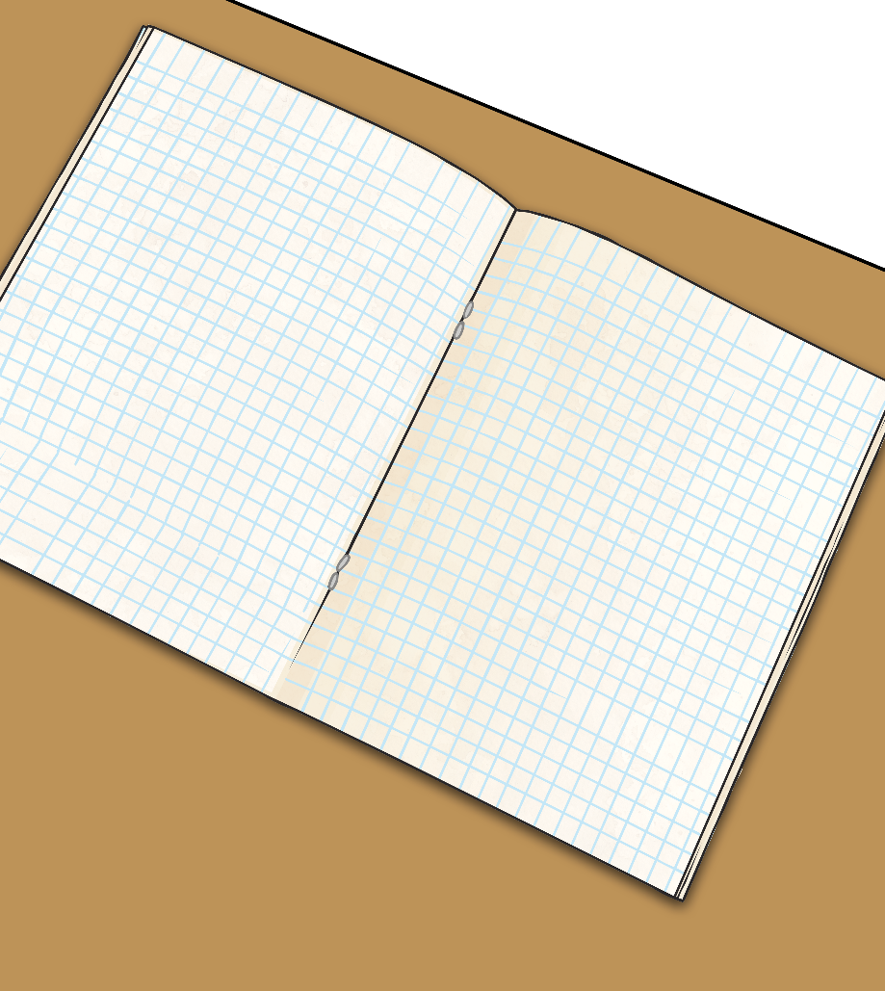
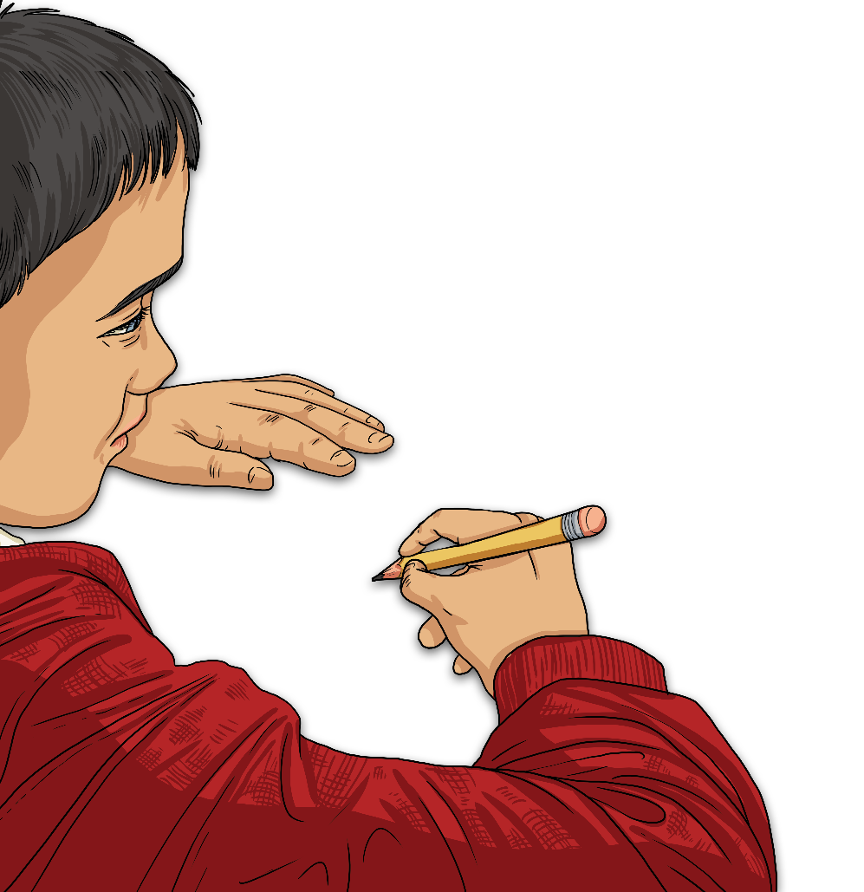
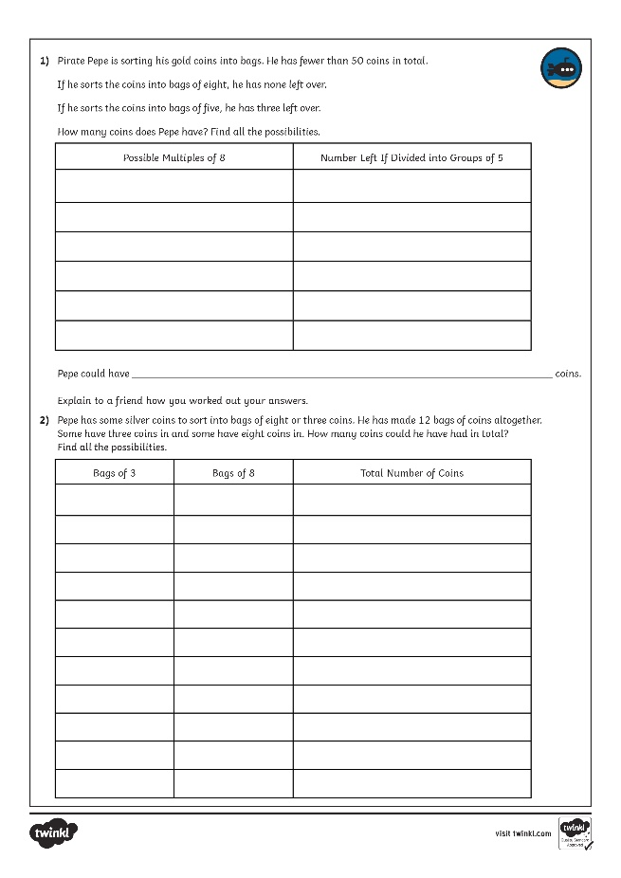
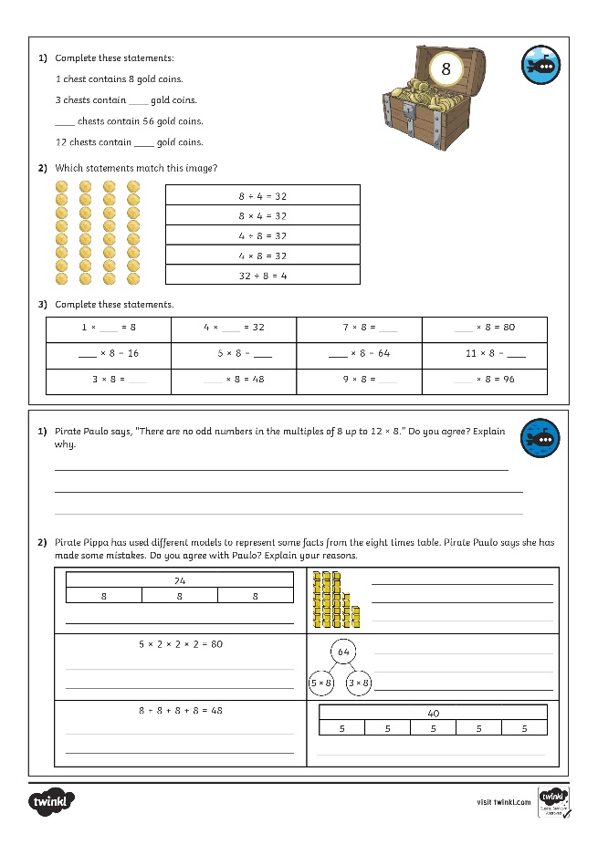
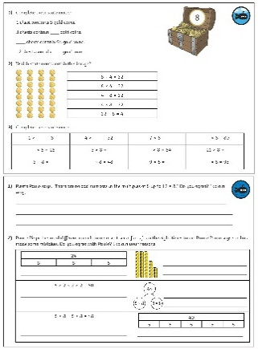
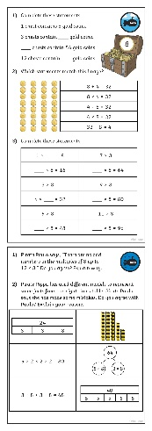
The 8 Times Table
Dive in by completing your own activity!

Slide 8
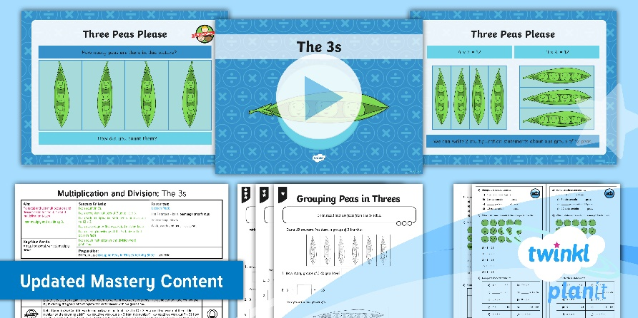
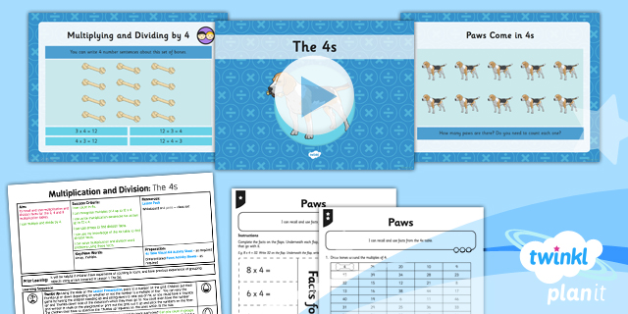

Need Planning to Complement this Resource?
National Curriculum Aim
Recall and use multiplication and division facts for the
3, 4 and 8 multiplication tables.
For more planning resources to support this aim, click here.
Twinkl PlanIt is our award-winning scheme of work
with over 4000 resources.

