Slide 2
Diving into Mastery Guidance for Educators
Each activity sheet is split into three sections, diving, deeper and deepest, which are represented by the following icons:
These carefully designed activities take your children through a learning journey, initially ensuring they are fluent with the key concept being taught; then applying this to a range of reasoning and problem-solving activities.
These sheets might not necessarily be used in a linear way. Some children might begin at the ‘Deeper’ section and in fact, others may ‘dive straight in’ to the ‘Deepest’ section if they have already mastered the skill and are applying this to show their depth of understanding.
Diving
Deeper
Deepest

Slide 3
Aim
Recall and use multiplication and division facts for the 3, 4 and 8 multiplication tables.

Slide 4
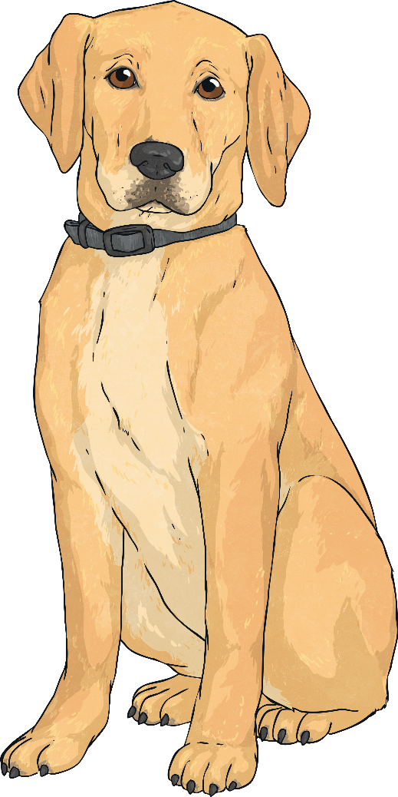
The 4 Times Table
Diving
Complete these statements.
1 dog has 4 paws.
2 dogs have paws.
dogs have 20 paws.
10 dogs have paws.
8
5
40

Slide 5
The 4 Times Table
Diving
Which calculations match this representation?
4 ÷ 8 = 2
2 × 4 = 8
8 ÷ 4 = 2
2 × 4 = 8
8 ÷ 4 = 2

Slide 6
The 4 Times Table
Deeper
Laaibah has represented some facts from the four times table in different ways. She has got some of them wrong. Tick or cross each representation and then explain the mistakes she has made.
 | ✓ | This model correctly shows 4 × 6 = 24 or 24 ÷ 4 = 6.
 | × | This model is not correct. It shows 4 groups of 4 equalling 12. Four groups of 4 equals 16, not 12.
 | ✓ | This model correctly shows 7 × 4 = 28.
12
4 | 4 | 4 | 4
5 × 4 = 20
2 × 4 = 8
20 + 8 = 28

Slide 7
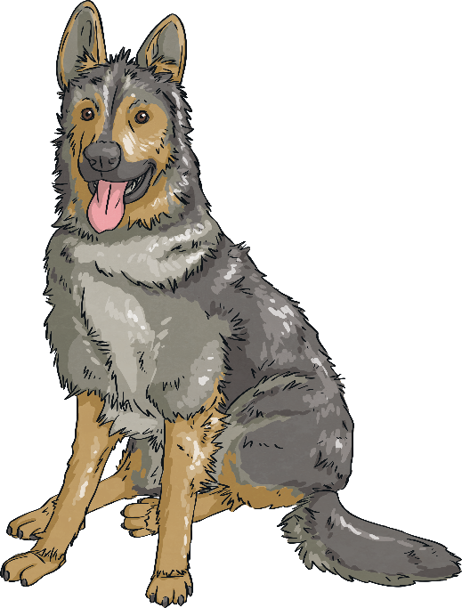
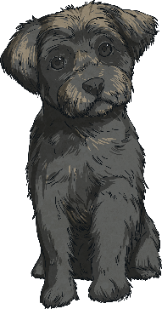
The 4 Times Table
Deepest
Jake has fewer than 20 dogs staying at his kennels. He must sort them into groups to decide how many dogs will stay in each kennel. If he sorts them in groups of four, he has none left over.
If he put 4 dogs in each kennel, he would have no dogs left over. If he put 3 dogs in each kennel, he would have 1 dog left over.
How many dogs could he have?
Find all the possibilities.
Possible Multiples of 4 | Number Left if Divided into Groups of 3
 | 1
 | 2
 | 0
 | 1
 | 2
4
✓
8
If Jake sorted the dogs into groups of 4, there would be no dogs left over. This means that the number of dogs must be a multiple of 4.
12
He could have 4 or 16 dogs.
16
✓
20

Slide 8
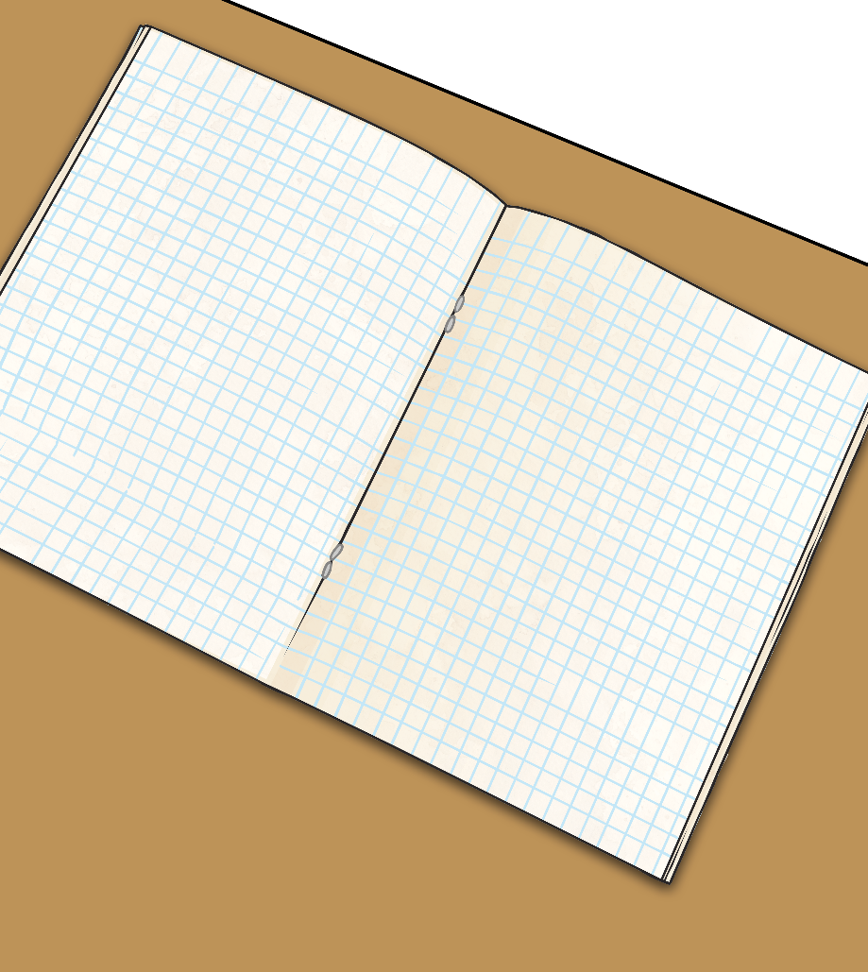
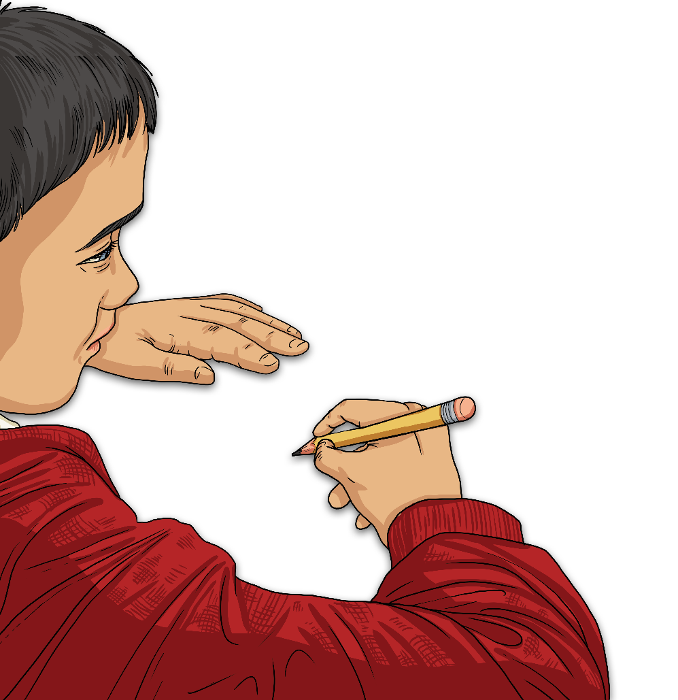
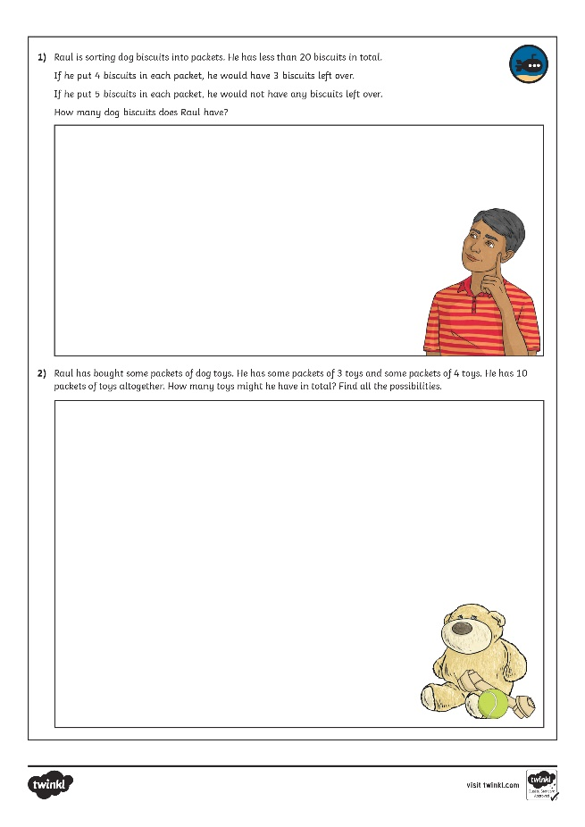
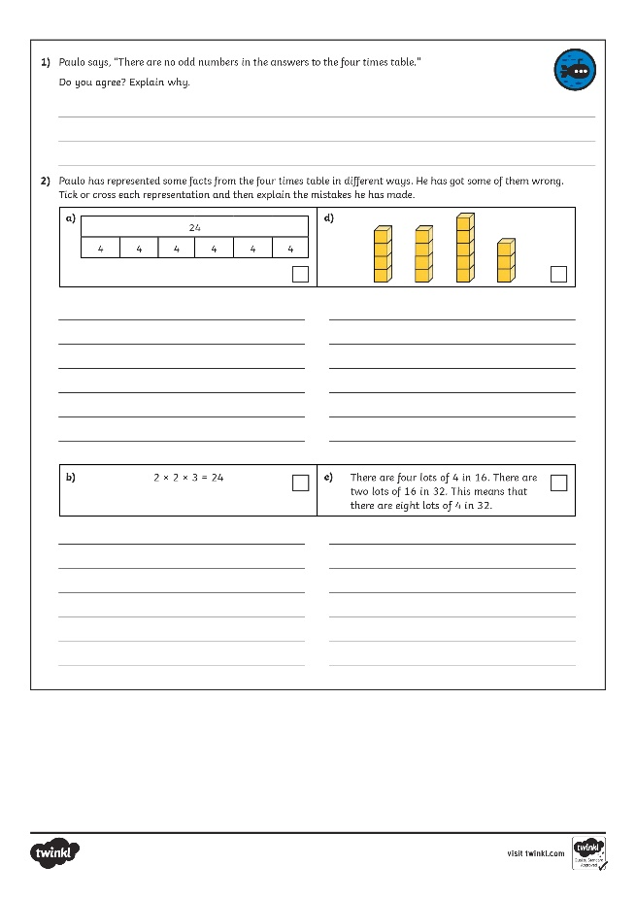
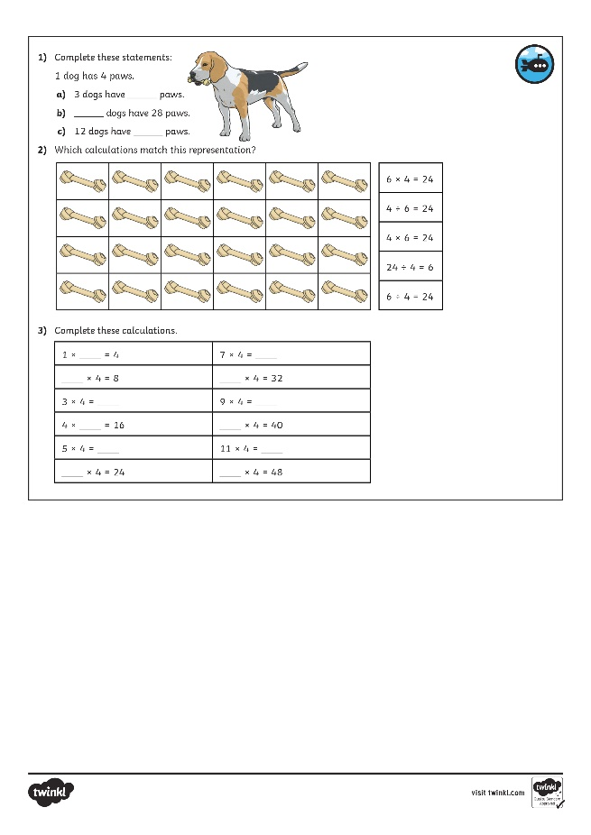
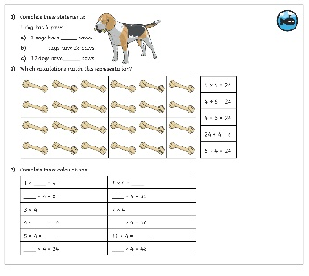
The 4 Times Table
Dive in by completing your own activity!

Slide 9
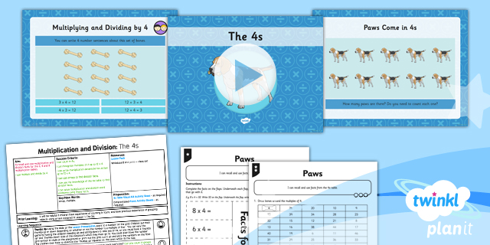
Need Planning to Complement this Resource?
National Curriculum Aim
Recall and use multiplication and division facts for the 3, 4 and 8 multiplication tables.
For more planning resources to support this aim, click here.
Twinkl PlanIt is our award-winning scheme of work with over 4000 resources.

