Slide 2
Diving into Mastery Guidance for Educators
Each activity sheet is split into three sections, diving, deeper and deepest, which are represented by the following icons:
These carefully designed activities take your children through a learning journey, initially ensuring they are fluent with the key concept being taught; then applying this to a range of reasoning and problem-solving activities.
These sheets might not necessarily be used in a linear way. Some children might begin at the ‘Deeper’ section and in fact, others may ‘dive straight in’ to the ‘Deepest’ section if they have already mastered the skill and are applying this to show their depth of understanding.
Diving
Deeper
Deepest

Slide 3
Aim
Recall and use multiplication and division facts for the 3, 4 and 8 multiplication tables.

Slide 4
The 3 Times Table
Diving
Complete these statements.
1 pod contains 3 peas.
2 pods contain 6 peas.
?
5 pods contain 15 peas.
?
10 pods contain 30 peas.
?

Slide 5
The 3 Times Table
Diving
Which statements match this image?
3 ÷ 6 = 2
6 ÷ 3 = 2
2 × 3 = 6
6 ÷ 2 = 3

Slide 6
The 3 Times Table
Deeper
Which models represent facts from the three times table?
Explain your reasons.
This model correctly shows 3 × 6 = 18 or 18 ÷ 3 = 6.
This model is not correct. It shows 4 groups of 4 equalling 12. To show 4 × 3 = 12, each lower part of the bar should contain 3.
12
4 | 4 | 4 | 4
5 × 3
+
2 × 3
= 15 + 6
This model correctly shows 7 × 3 = 21 but the final calculation 15 + 6 needs completing to show the answer.

Slide 7
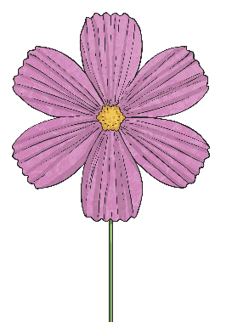
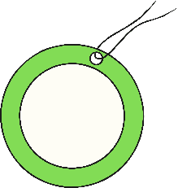
The 3 Times Table
Deepest
Jake is choosing flowers for a bouquet
He spends £20. What combinations of flowers might he have chosen?
Find all the possibilities.
£2
£3
1 × 2 = 2 | 6 × 3 = 18
4 × 2 = 8 | 4 × 3 = 12
7 × 2 = 14 | 2 × 3 = 6
10 × 2 =20 | 0 × 3 = 0

Slide 8
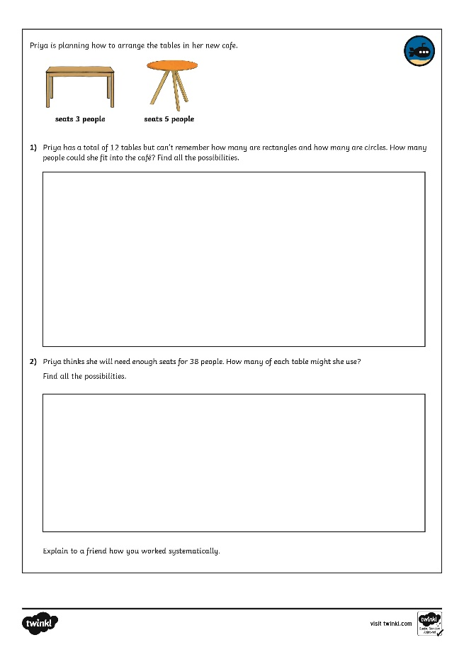
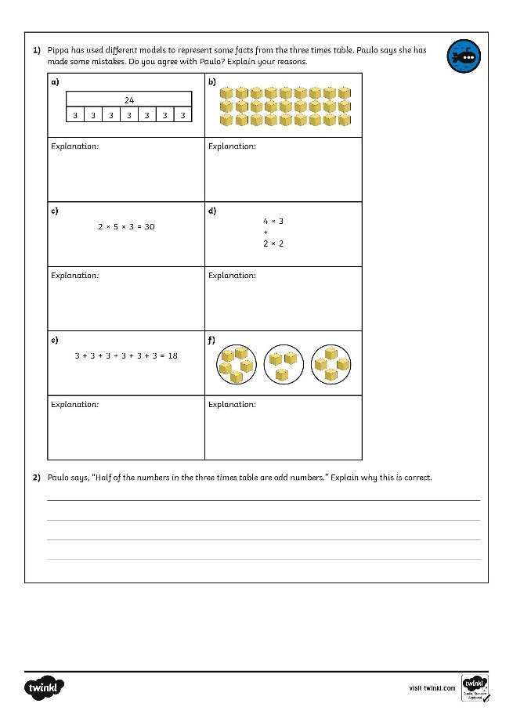
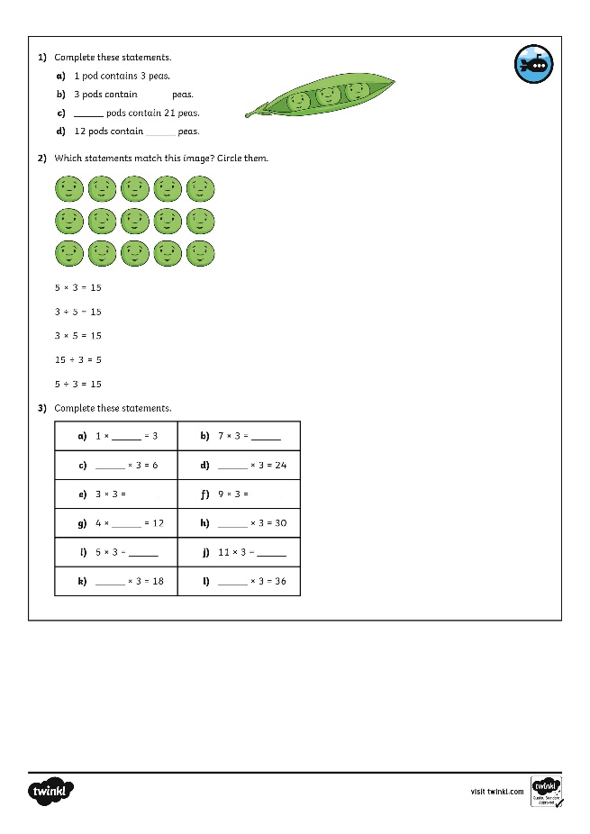
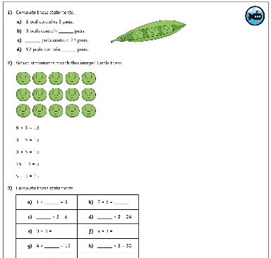
The 3 Times Table
Dive in by completing your own activity!

Slide 9
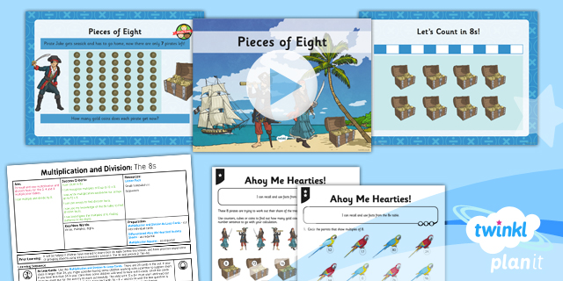
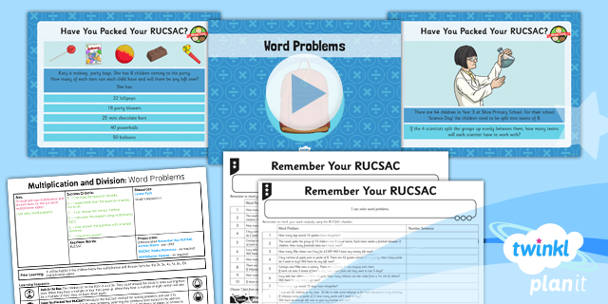
Need Planning to Complement this Resource?
National Curriculum Aim
Recall and use multiplication and division facts for the 3, 4 and 8 multiplication tables.
For more planning resources to support this aim, click here.
Twinkl PlanIt is our award-winning scheme of work with over 4000 resources.

