Slide 2


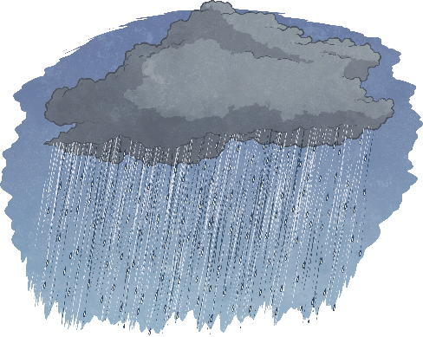
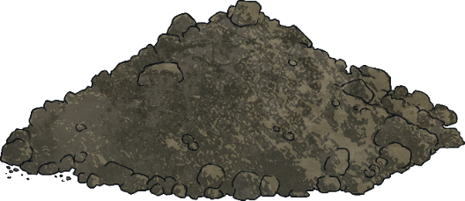
What a Plant Needs
air
    light
    water
nutrients
warmth

Slide 3
Why Does it Need Them?
If a seed is not warm enough, it will not germinate
Germination is when the seed starts to sprout in to a plant
If a plant does not have enough light, it will grow to be tall and flimsy as it searches for light. It will probably die.
If a plant is not watered enough, its stem will be fragile and have very dry leaves. It will eventually die.

Slide 4
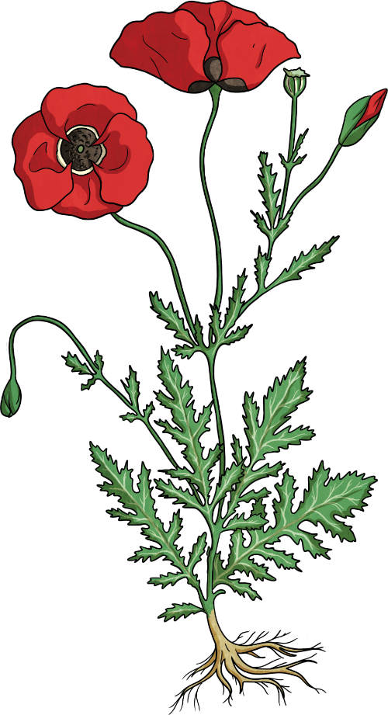
What Parts of a Plant Do
The leaves use a process called photosynthesis to produce food for the plant. They use light, water and carbon dioxide to do this.
The stem transports water and nutrients to all parts of the plant.
The roots take up water and nutrients from the soil.
They also keep the plant in the ground.

