Slide 2




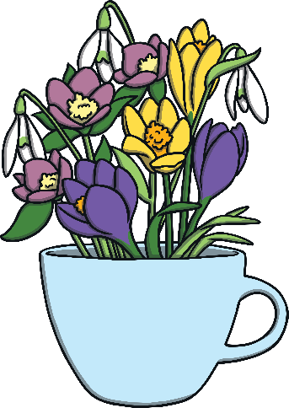



Spring
Spring is one of the four seasons.
\\
autumn
winter
spring
summer

Slide 3
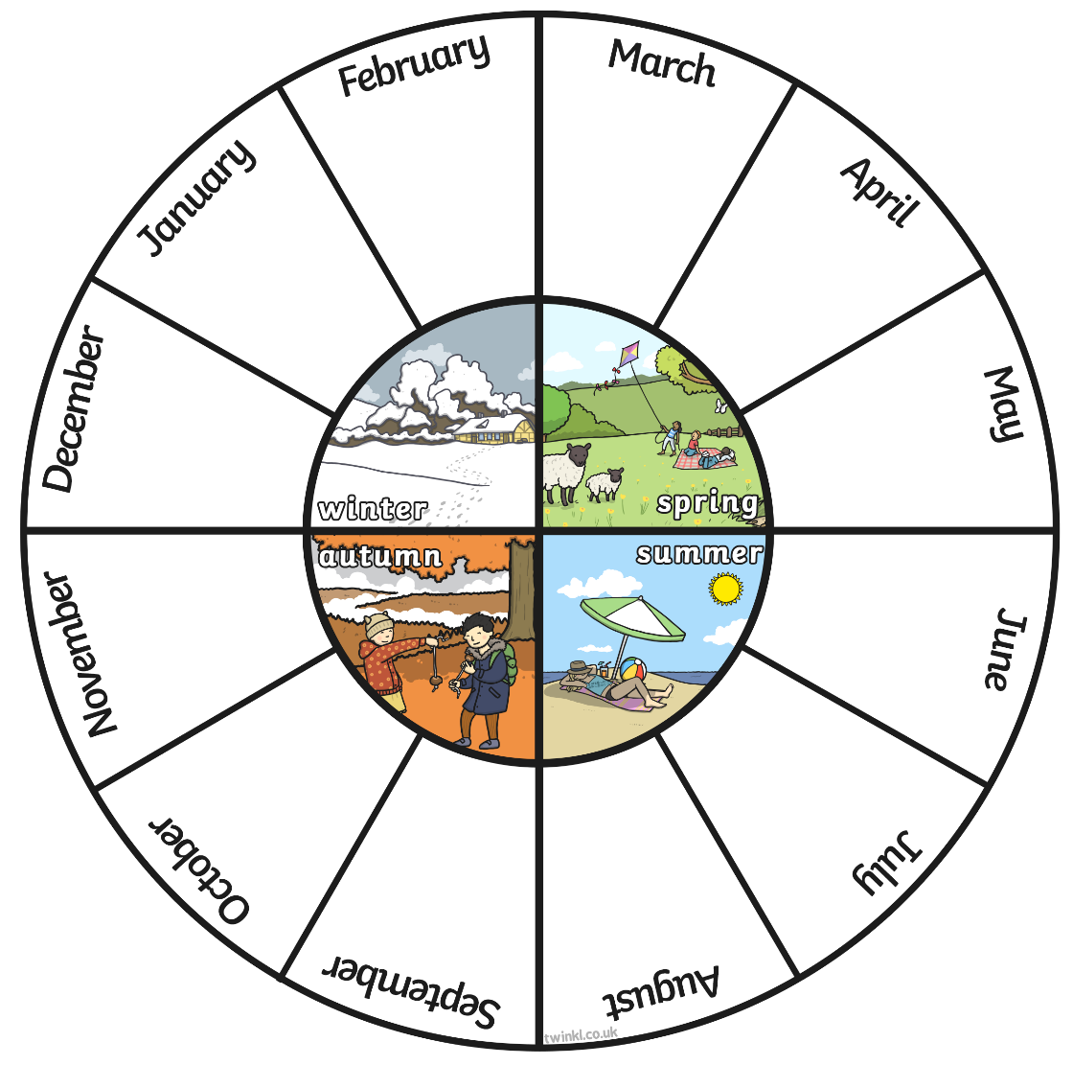
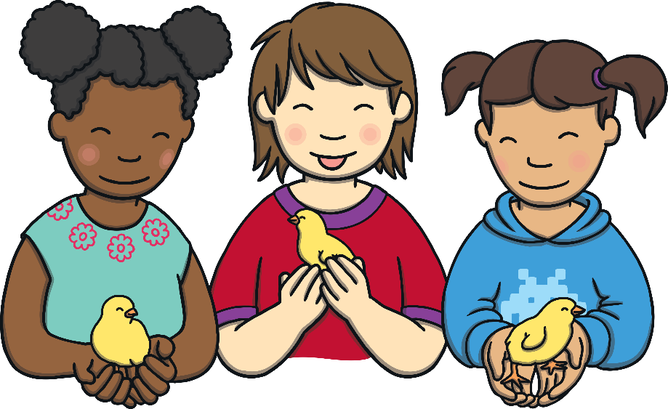
Months and Seasons
The spring months are March, April and May. Spring comes after the season of winter and before summer.
This wheel shows the different seasons and months of the year.
Can you see the months of spring?
What other seasons can you see?
What season is your favourite?

Slide 4
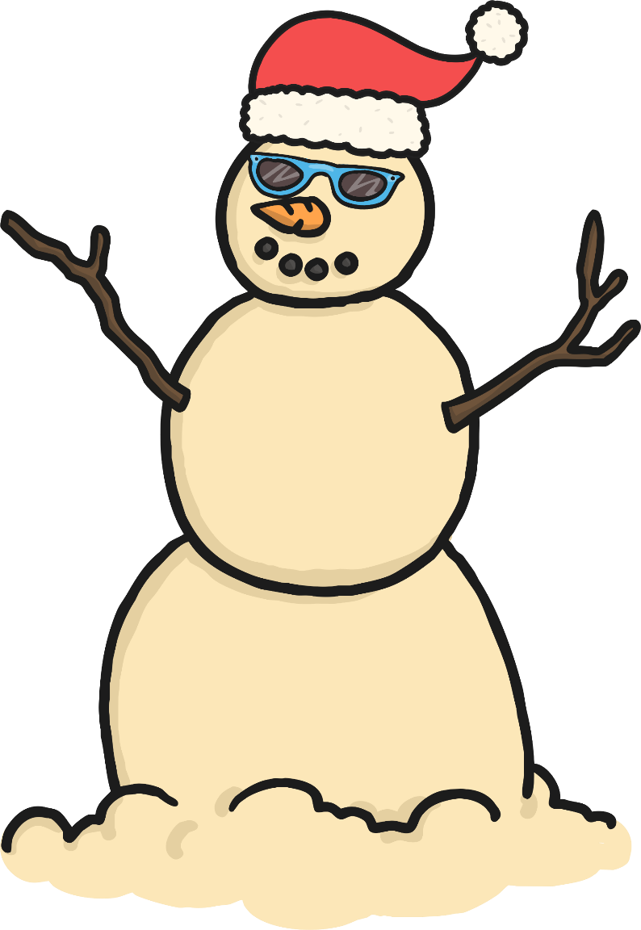
Spring around the World
Spring falls in different months of the year, depending on where you are in the world.
In other countries, such as Australia, spring is in September, October and November!
They experience the seasons opposite to those in the United Kingdom.
When it is winter in the UK, it is summer in Australia.
When it is spring in the UK, it is autumn in Australia.

Slide 5
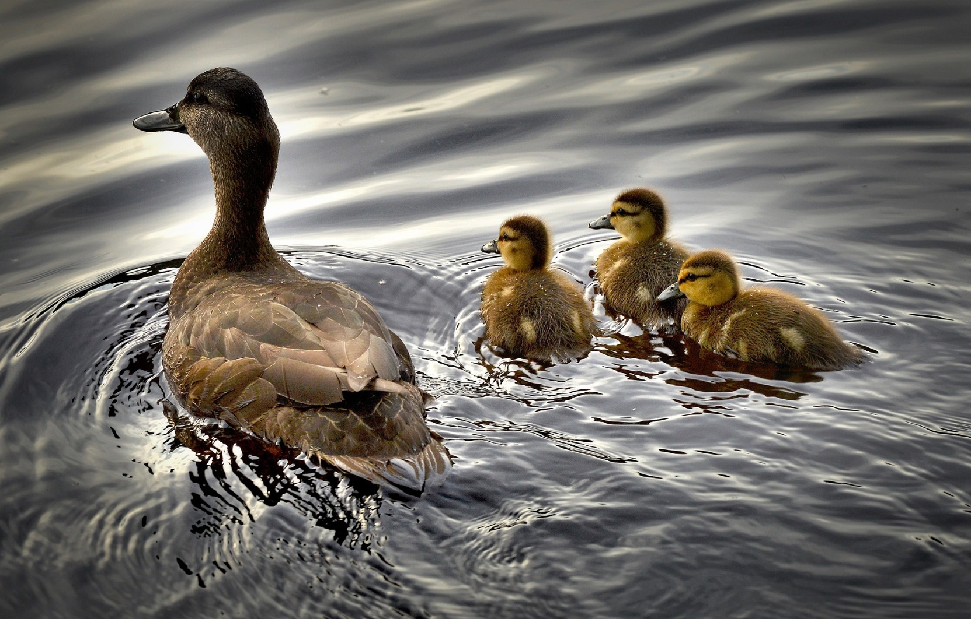
What Does Spring Look Like?

Slide 6
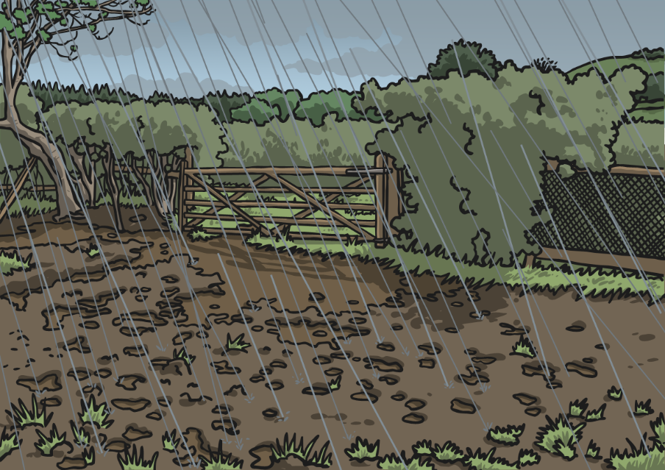
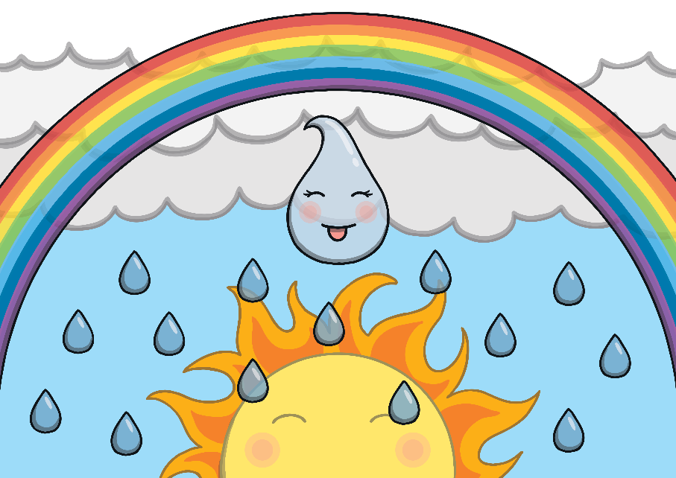
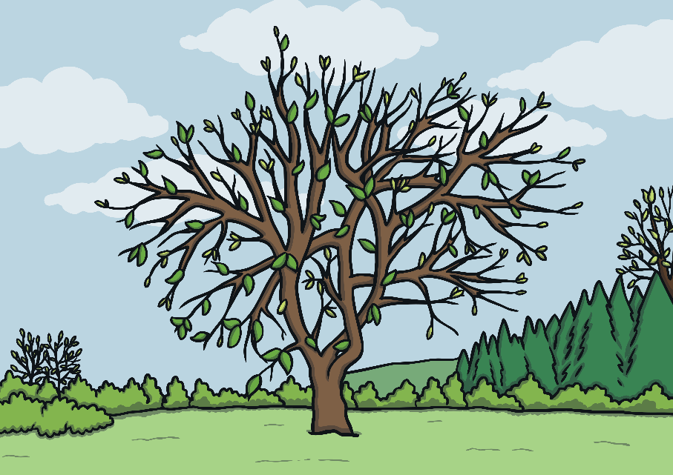
Spring Weather
Spring weather can be mixed.
What kinds of weather can we experience in spring?
Springtime is often sunny and rainy – you might see a rainbow in the sky!

Slide 7

Lighter Evenings
You might notice that the daytime gets longer and longer during the spring months. This means that the evenings are lighter - it may still be light when you go to bed!
Month | Sept | Oct | Nov | Dec | Jan | Feb | Mar | April | May | June | July | Aug
Hours of Sunlight | 13 | 11 | 9 | 8 | 8 | 10 | 12 | 14 | 15 | 16 | 16 | 14
spring
What numbers can you see on this table?
How many hours of sunlight will we have in March?

Slide 8
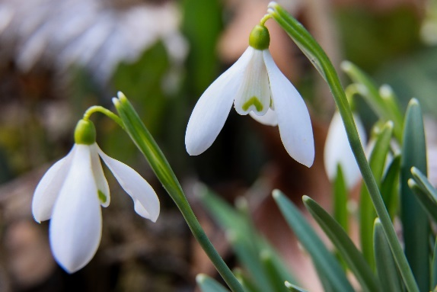
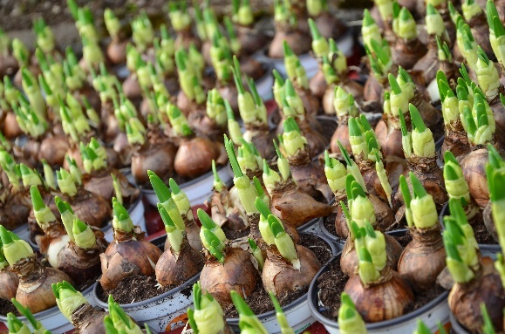
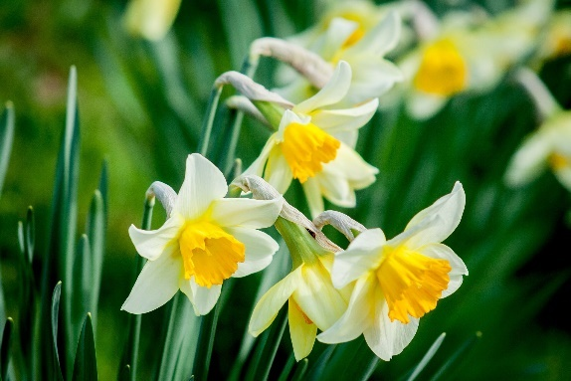
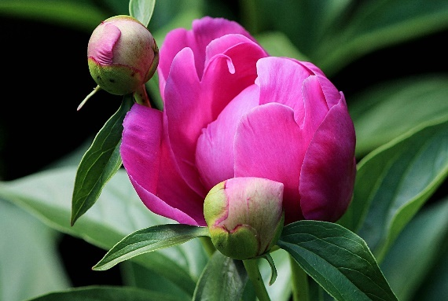
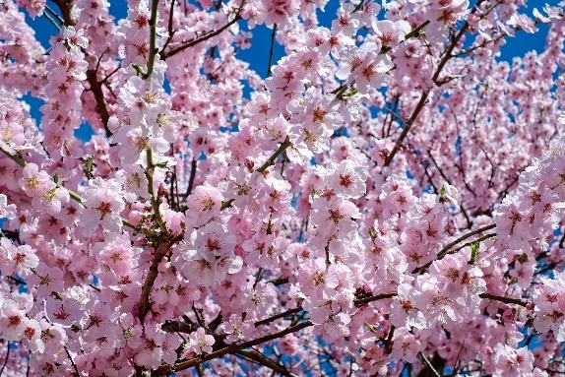
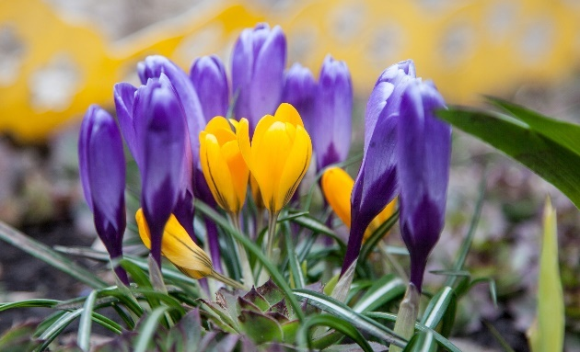
More Signs of Spring
snowdrop
bulbs shooting
daffodils
flower buds
blossom
crocuses

Slide 9
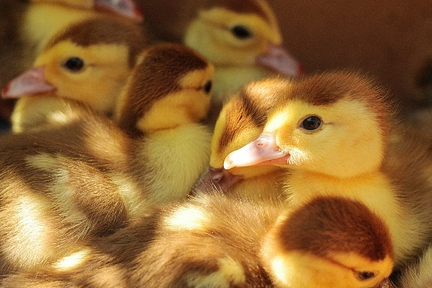
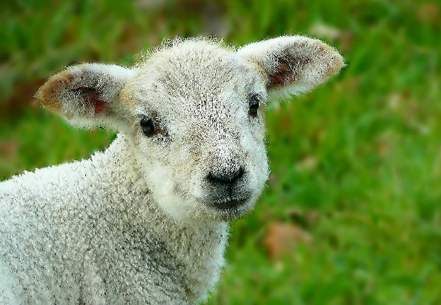
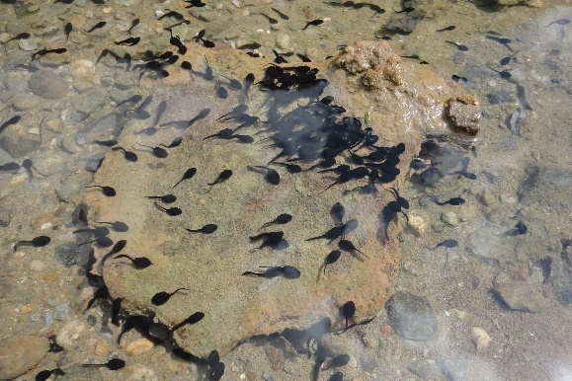
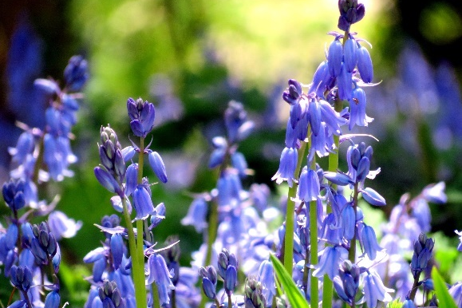
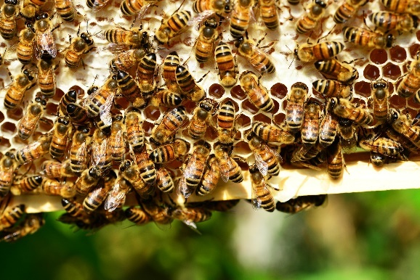
More Signs of Spring
Spring is time for new life and growth. Lots of baby animals are born in the spring. You might spot bluebells and other flowers growing too. You might see some tadpoles in a pond – do you know what tadpoles grow into?
chicks
lambs
tadpoles
bluebells
bees

Slide 10
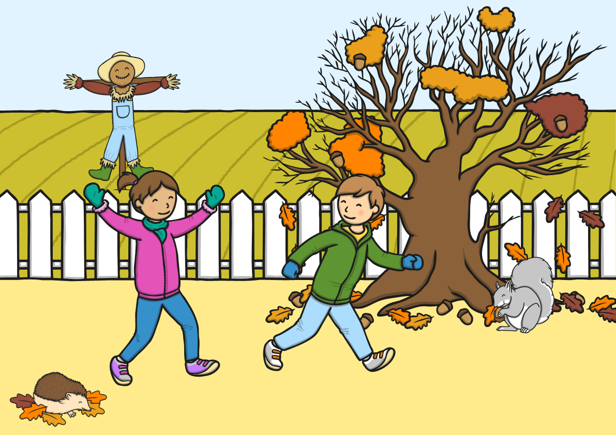
How is Spring Different to Autumn?

Slide 11
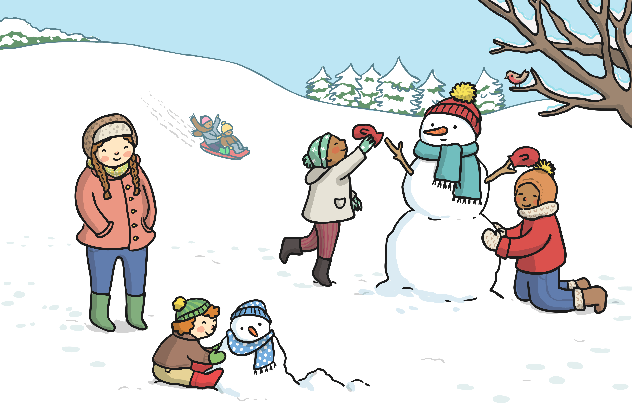
How is Spring Different to Winter?

Slide 12
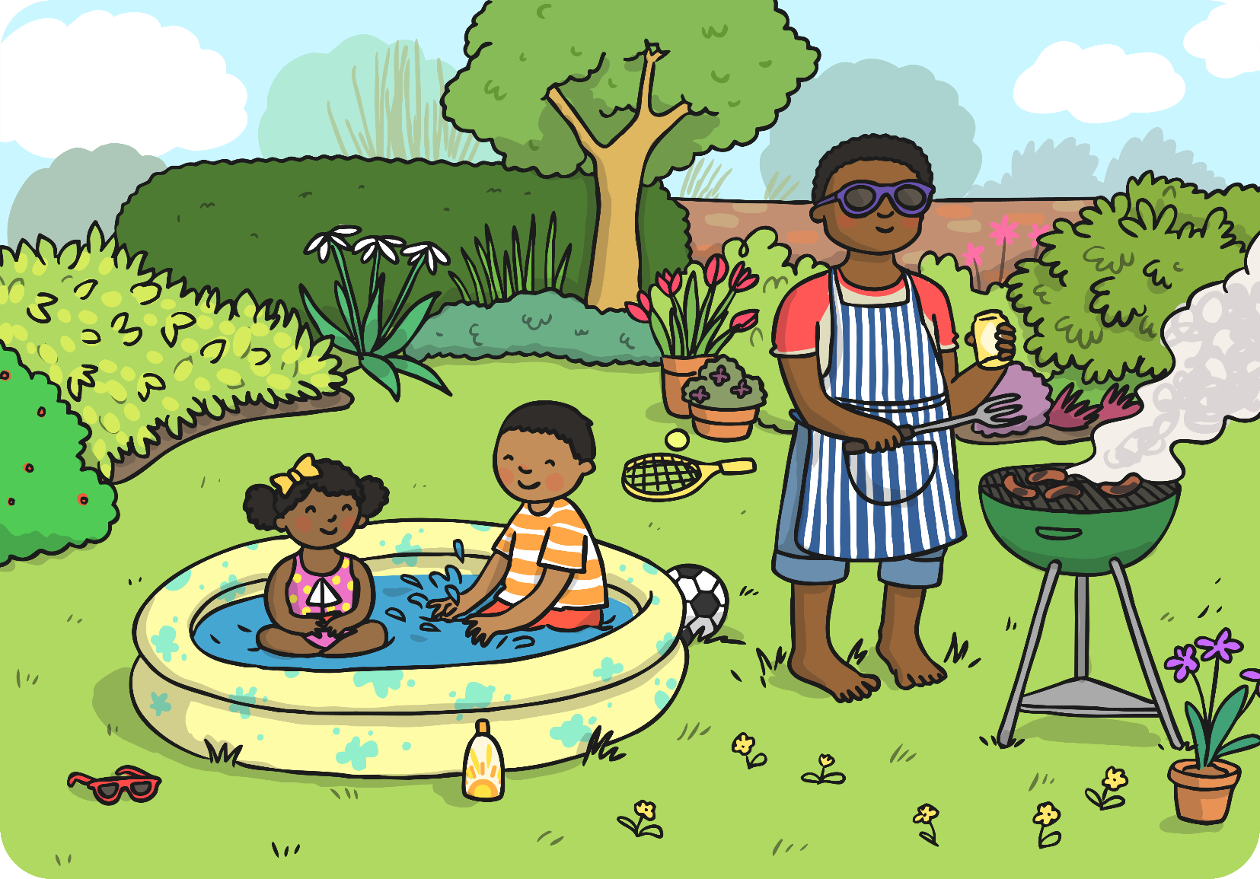
How is Spring Different to Summer?

Slide 13
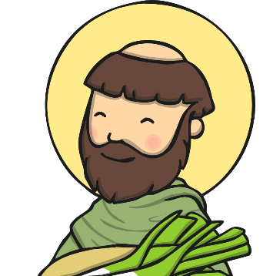
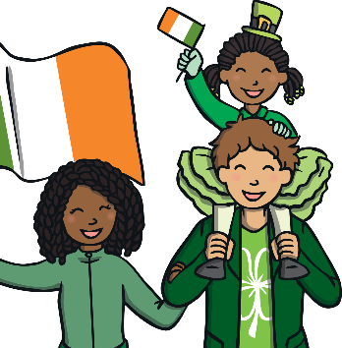
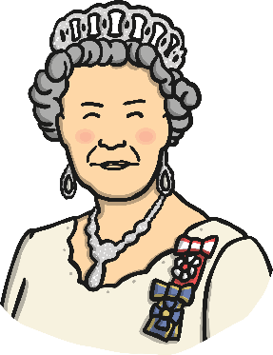
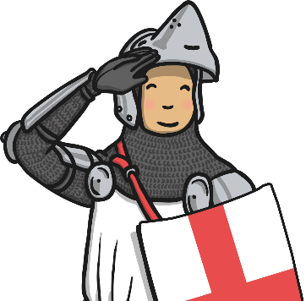
Some Special UK Spring Dates
St. David’s Day (Wales) – 1st March
St. Patrick’s Day (Ireland) – 17th March
Queen Elizabeth II’s birthday – 21st April
St. George’s Day (England) – 23rd April
Mother’s Day and Easter are often celebrated in spring too.
Will you be celebrating any of these events?

