Slide 1
World Mental Health Day 2018

Slide 2


Slide 3
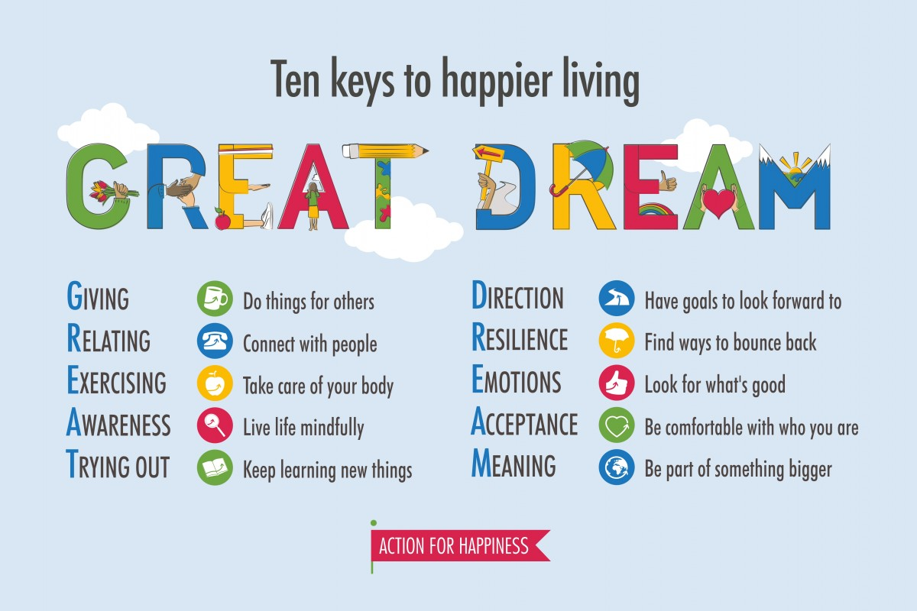

Slide 4
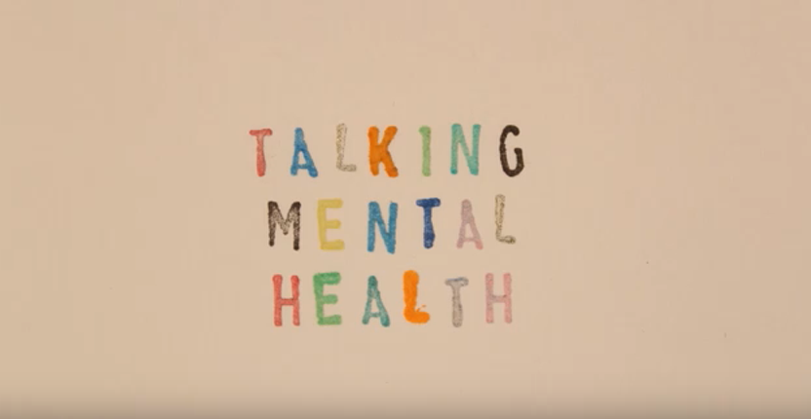
https://youtu.be/nCrjevx3-Js

Slide 5
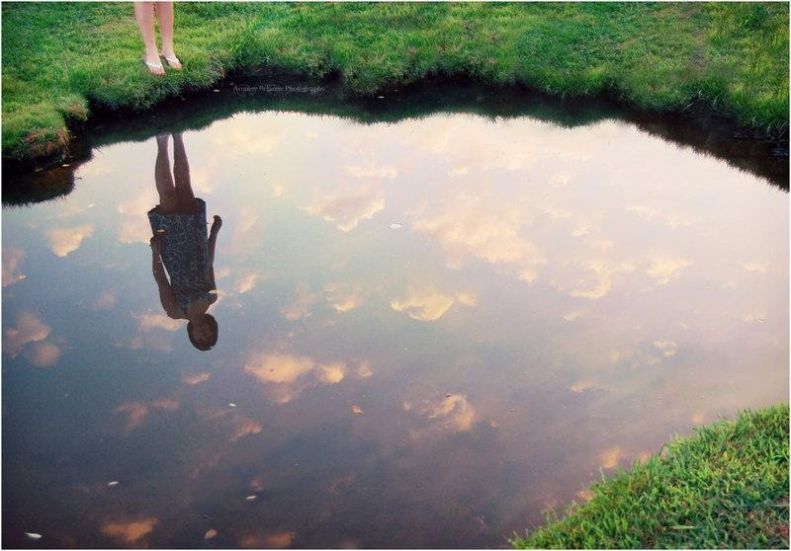
Reflection

Slide 6
Please tell your parents about today
Reflect together
1 good
1 bad
1 funny

Slide 7
The power of a gratitude attitude
What or who have you been grateful for over the last week?
What or who have you been grateful for in the last day?
What or who have you been grateful for in the last hour?

